Slide 1

Notes:
Astrophotography is in many ways an arcane art.
We don’t really have an image so much as tables of data shown in an image format.
Most of our time is spent manipulating the data to bring out the details we are looking for.
In some cases the actual relevant data is not what the eye immediately perceives.
Astrophotographers take our images for any number of reasons. None of the categories below are exclusionary and in fact some skill in all three is the norm. It’s just that the Astrophotographer favors one over the other.
Some of us just like taking pretty pictures. In terms of aesthetic appeal most of their images are way prettier than mine.
Some of us just like the processing itself- which a times can be an arcane art. These people bring out even the most delicate of details.
Some of us are less interested in the arcane details of taking and processing image but more interested in what our images can tell us about the object. This is at the heart of using our images as Science Frames. I myself fall into this category.

Slide 2
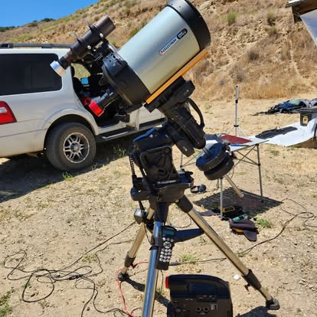
Notes:
Here is my imaging rig.
The instrument is a 8” Celestron Edge HD SCT.
The Mount is the Celestron CGX German Equatorial Mount.
The red camera is a ZWO ASI294MC one shot color camera. Technically ZWO calls this a Planetary camera.
In general a camera should be balanced for the telescope. However there really are no cameras on the market optimized for the SCT so I have to use one that is useable.
The silver camera on the Orion 240 mm Guidescope is a Orion Monochrome SSAG guiding camera.
It is not shown here but I also use an un-modified Canon SL-2 DSLR mounted piggyback. My two standard lenses are a 50 mm and 300 mm. Normally I set the camera f number to be two stops greater than the shortest f ratio. I find I get better quality star images.
Everything here is controlled by a typical laptop.
My standard software packages are
Starry Night Pro + 8 for as my Planetarium software.
PHD2 is used for guiding.
I use the Canon remote software to set the imaging run parameters.
I use the ZWO ASIAir package to stack in the field and check on my imaging process.
Because I do not have a permanent location I do not use scheduling software or filters in my imaging. While I can automate some of the processes I can not roboticize the scope.
While my imaging runs can be automated I usually have to monitor the progress of the imaging.

Slide 3

Notes:
A Bias frame is the electronic noise introduced by the very act of reading the content of the pixels in the imaging sensor.
This frame has been stretched to show the details. In reality the frame is very dark.

Slide 4
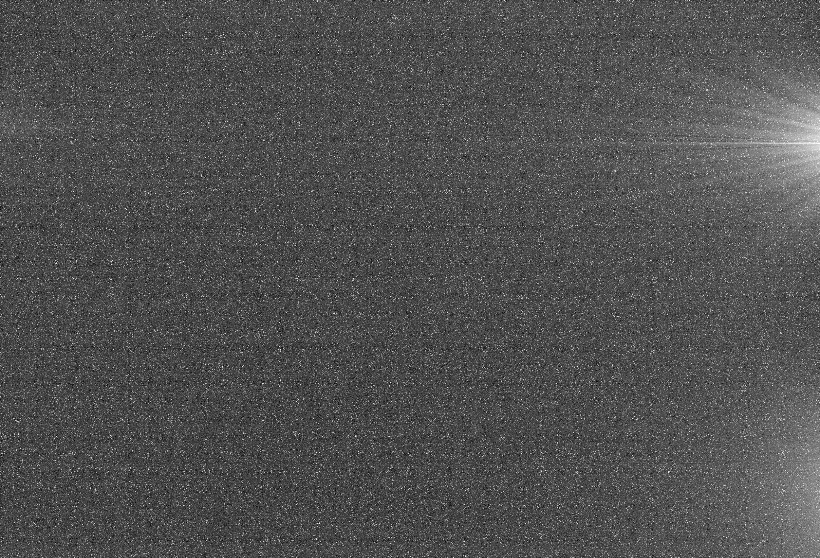
Notes:
Dark image is the inherent electronic noise present in all electronically taken images.
Normally you won’t see these in your usual daytime shots but it becomes apparent in dark astronomical images.
Sometimes this noise can be mistaken for data and has to be accounted for.
Key feature here is the rayed thermal noise called amplifier glow. This is very difficult to fully process out.

Slide 5
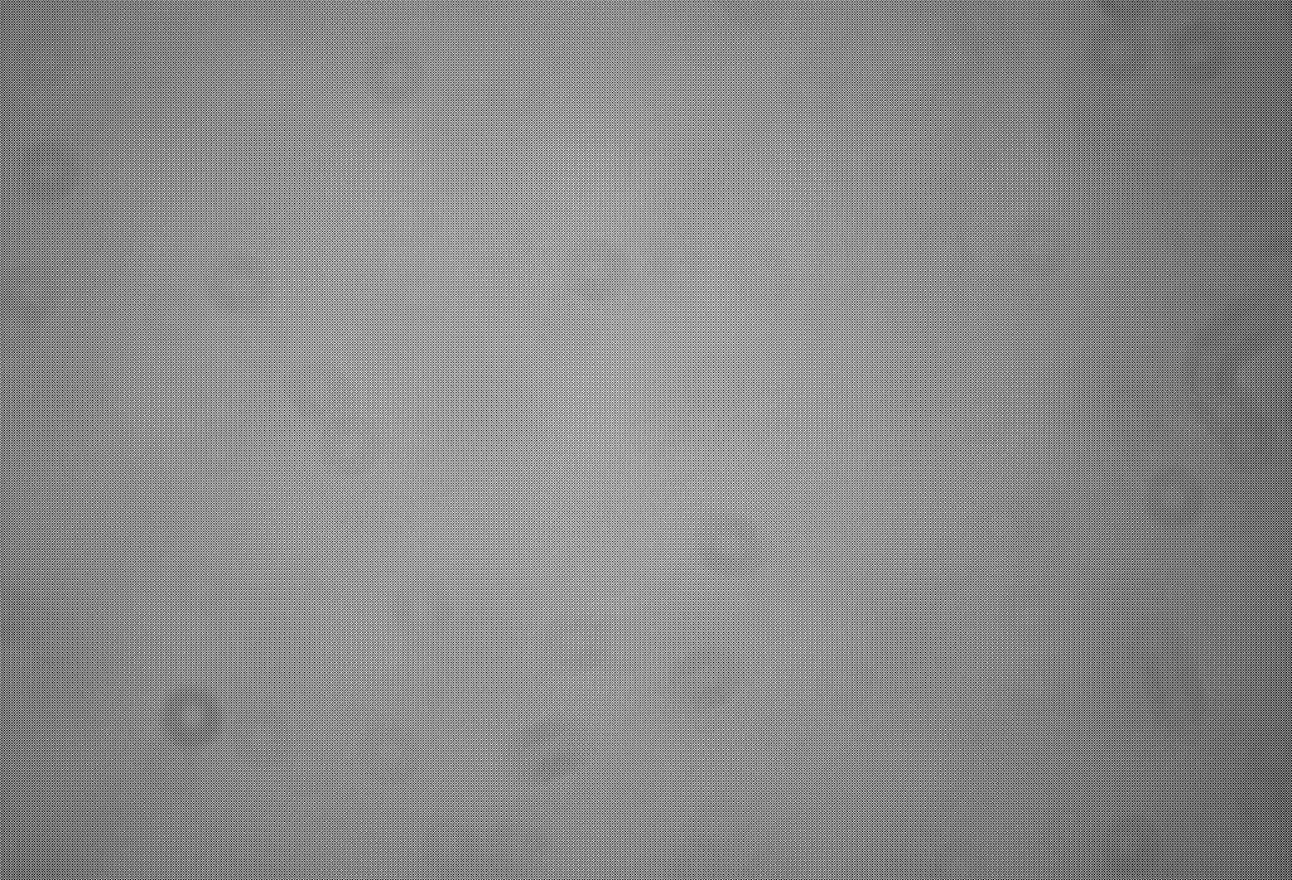
Notes:
A Flat Frame is a reference frame that shows optical defect - uneven illumination, distortion, dust on the lens etc.
Those dougnb=nut are dust particles.

Slide 6
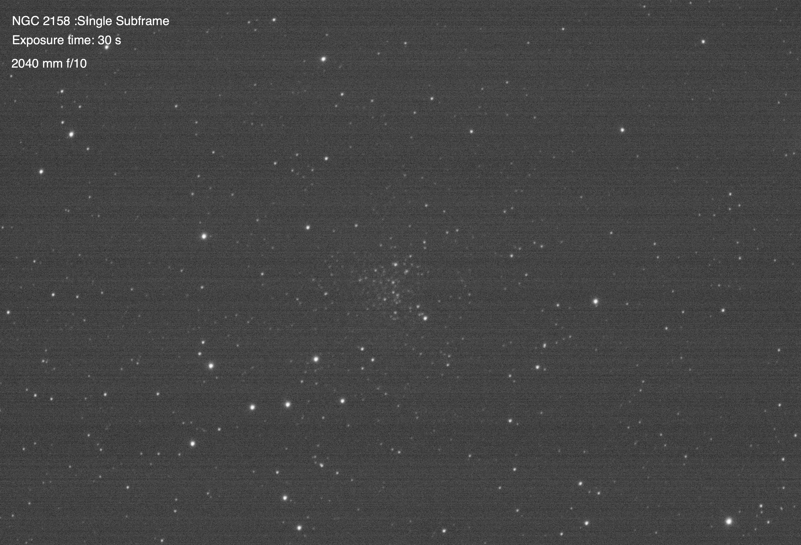
Single Subframe of NGC 2158 300 sec exposure
2000 mm f/10
Notes:
A Light frame is the image of the actual target.
A Science Frame is a light frame processed to study.
The same light image may be processed in any number of ways to highlight various aspects of the target for study.
You can make any number of different Science Frames from the same Light Frame.

Slide 7
PRE IMAGING SETUP
Telescope set-up (Install all cameras and auxiliary equipment such as cameras, focal reducers, finders, dew heaters etc)
Balance OTA in both Axis
Telescope Alignment -both initial alignment and fine Polar Alignment
Guiding Preparation- Set up Planetarium software, PHD2, and Imaging software
Focus guiding camera with Bhatinov Mask and perform guiding camera calibration and Meridian Flip.
Focus imaging camera and set up image framing.
If you are using scheduling software set up imaging sequence
Notes:
For best practices it is preferred to standardize your processes as much as possible.
This first set of procedures is used before I start imaging

Slide 8
IMAGING SEQUENCE
Take Calibration Frames - Bias , Darks, and Flats. Some people take special Dark Frames for their flats but they really isn’t necessary.
Calibration Frames do not need to be taken every session. However-environmental conditions should be as close as possible to the temperature associated with the Light Frames.
Light Frames. Take according to your standard. My standard is a minimum of 180 minutes total integration time. Take enough extra Light Frames to count any un-stackable frames. The generally accepted practice is to take extra frames amounting to 10 % to account for bad frames. I normally take 240 minutes total
Notes:
Calibration frames are critical for effective processing.
Some people take them before main imaging session , some in the middle, and some at the end. Bias and Dark frames should be taken at the same temperature as the light frames.
Others- myself included -prefer to set up a library of them at various temperatures.
Flats are the ones that need to be updated most often.
Flats are something of an arcane art .I find the best flats are taken with what has to be the dumbest and least scientific method of all.. I put a clean t-shirt over the lens and stretch it out to make sure there are no wrinkles. I have found this works better that using a white wall, a luminescent panel, your laptop screen set to white, or twilight flats taken during the shot period where the sky light gradient is minimized.
The light frame times are probably the standard I most often violate.
For Star Clusters I use 30 second frames which preserve star colors.
For nebulous objets I take 5 minute subframes. That 5 minutes is limited by the mount itself. But 5 minus exposure also tends to saturate star images causing the loss of color
The 3 hour standard I use is a minimum. I prefer as long as possible. Often seeing conditions will require I image the same object over several nights.

Slide 9
Pre-Processing
Make master dark frame
Make master bias frame
Make master flat frame
Calibrate light subframes
DeBayer light subframes
Reject bad images
Perform plate solve for light frames
Select reference light frame
Register light subframes
Normalize light subframes.
Stack light subframes to make master light frame
Autocrop master light frame to get rid of stacking artifact.
Notes:
Once we have our images we have to process them.
This is where you take your raw images and convert them into a master for processing
There are any number of software packages to do this.
Photoshop and Pixinsight are the two most popular ones.
Pixinsight is specifically designed for deep sky astrophotography and is the package I use.
There is a shareware package called GIMP which has been described as “Photoshop Light”
For these steps Pixinsight has automated the whole process with a tool called Weighted batch processing.
You just enter your images, select some settings, (the default ones work very well) , tell the software where the images are to go and hit the run button.
Now you can walk away until it finishes. When i have a lot of frames to process it can take hours . But in the end it will give you a master cropped image to play with.
I save the master Bias, Dark and Flat frames it produced in a Calibration Frame Library so I don’t have to take these every imaging run.

Slide 10

Raw freshly stacked image of NGC 2158.
WTF? Where’s my data?
Notes:
Uggh. Here’s my final image.
It’s dark because there is very little dynamic range in the final image.
Pixinsight assigns every pixel a brightness range from 0 (pure black) to 1 (pure white)
The brightest pixels in this image have a value of 0.003.
I will have to stretch this to see anything.

Slide 11
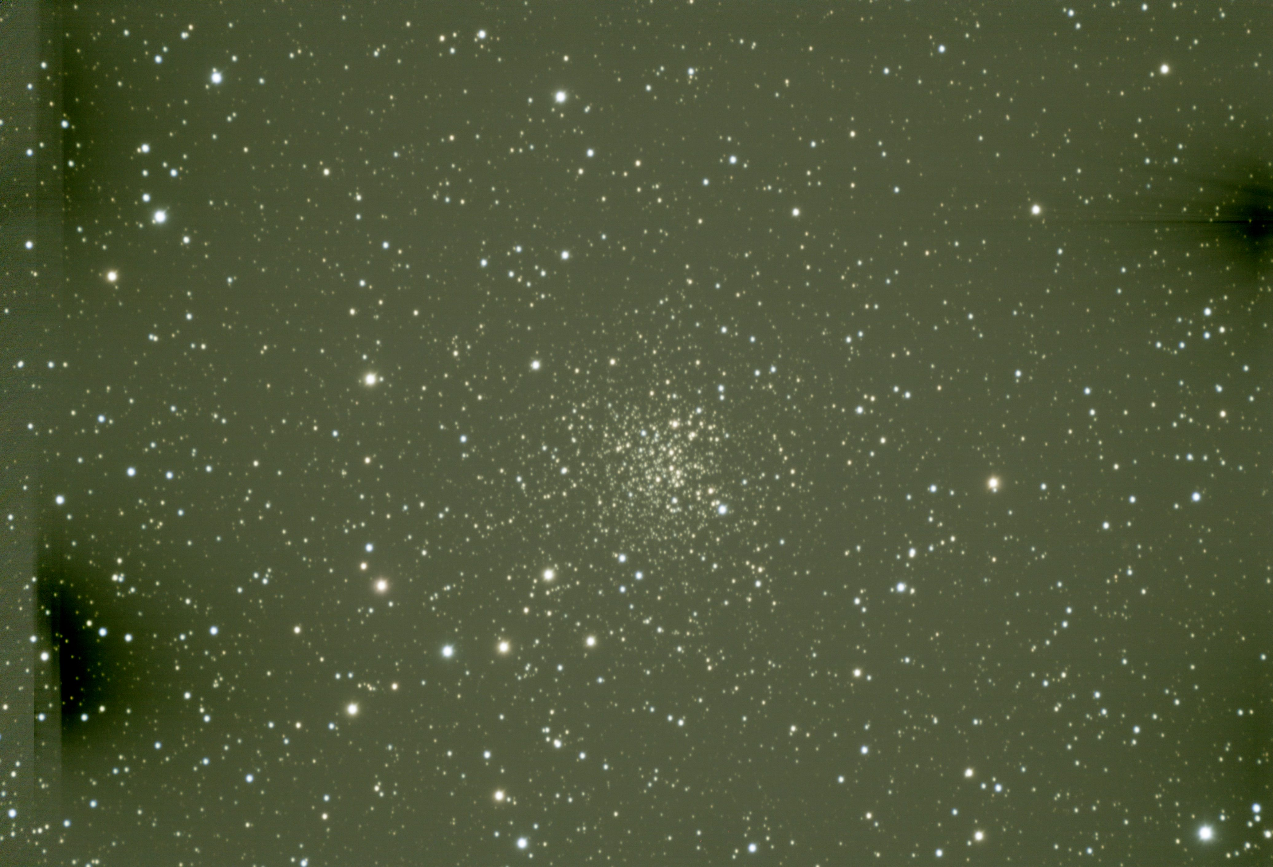
NGC 2158 Unprocessed master image really sucks.
Notes:
Here is the stretched image.
Notice the green haze? The night sky fought me every step of the way.
1’st night I had tp abort the imaging run after only an hour and a half when the clouds moved in.
The 2’nd night dew was so heavy it overwhelmed the dew heaters. i simply gave up after four hours (Yes-I’m stubborn that way)
Finally I had decent conditions on night 3 although I did have clouds come and go.
The good part however is that I got 7 hours total of useable data.
Notice the amplifier glow? The calibration frames were unable get rid of it all.

Slide 12
Processing -Common steps
Examination of frame-Crop if necessary
If you crop - redo Plate Solve
Color Channel Balance
Background Extraction
1’st Star Correction
Background neutralization
Color Calibration
Main star reduction
Noise reduction
Separate stars from Nebula or Galaxy.
Stars are processed separately from nebulae
Notes:
The steps here are common ones that are used in the initial stages of every taste image I take.
At this stage the data is linear. Nothing has been stretched. These steps are primarily concerned with getting rid of the garbage in the image- i.e the green glow, stacking artifact, removal of light gradients, etc.

Slide 13
Processing - Bringing out the data
Stretch image. There are any number of tools you can use.
Image processing is sometimes more of an arcane art than science. You process to fit what you are looking for.
You will make special masks to make changes on just the parts of the image you want while protecting the rest.
In nebula or galaxies you want to tone down the cores- ex. in M-42 you may want to suppress the intensity of the central core so you don’t lose the Trapezium.
In Galaxies you want to enhance small scale structure - for example dust lanes. H-II regions, etc.
SAVE YOUR IMAGE AT EVERY STEP BEFORE GOING ON TO THE NEXT!
For stars you may want to reduce them further. If you get ringing (rings around stars) you just have to backup a step or two and redo them .
For both images- perform Color saturation. It’s is very easily to overdue this step.
Recombine your stars with your nebula.
Fine tune if you need to
Notes:
At this step the image has been stretched to increase the dynamic range and is now non-linear.
These steps are specific to the type of object you imaged.
Separating the Stars from the Nebula allow you to work on them separately. The techniques for handling stars are quite different than the tools used for nebula.
The cool thing about masks is that you can invert them- i.e you can set the mask to protect the background and you just work on your object then invert the mask to protect you object while you work on the background.
There is no hard and fast rule here on what steps to use. That’s what makes image processing more of an arcane art than a science.

Slide 14
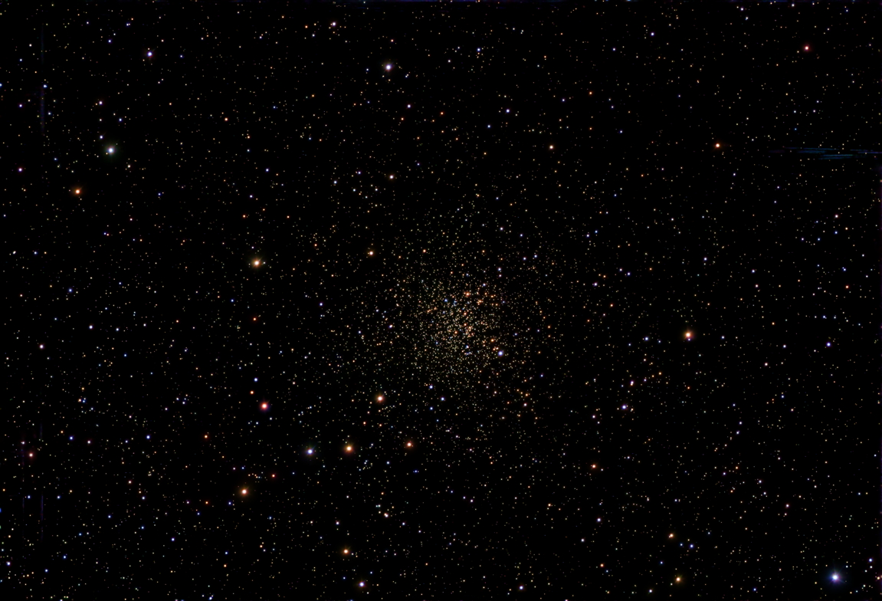
NGC 2158 Final image
Notes:
Here is the final image of the Open Cluster NGC2158 I’m Gemini (the teeny weeny cluster sitting on the edge of M 35)
Notice a the upper right there is still a little bit of garbage from amplifier glow. I was unable to get rid of it entirely

Slide 15
Images tell us something about our Universe and the Objects we are imaging.
Problem- how to decipher what we are actually seeing.
Do you know what a layer cake looks like?
More importantly- Do you know what a layer cake looks like if you are between the layers?
Astro photos show the object in three dimensions but appear two dimensional to us. We are between those layers.
Let’s look at the Milky Way “cake”.

Slide 16
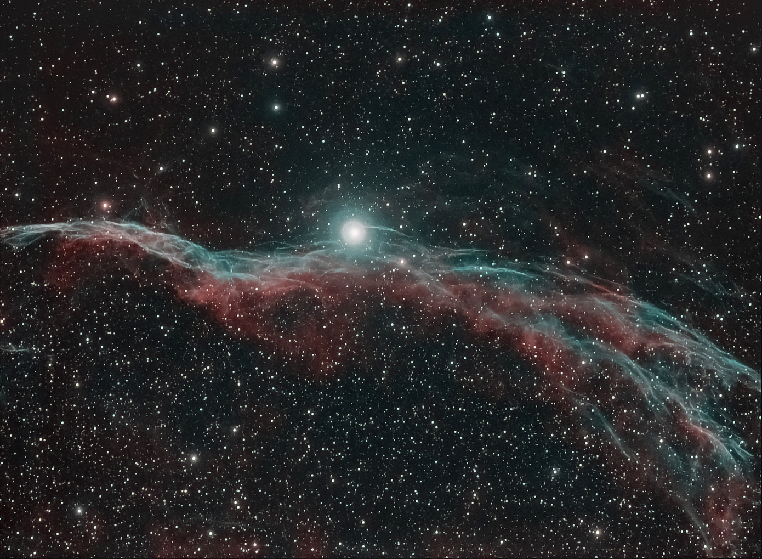
Notes:
This is not my image but I am using it to make a point. Notice the star count below the nebula as compared to above it.
The nebula is the shock front of an expanding bubble in space from a Supernovae that occurred more than 10000 years ago.
It is often used in textbooks as an example of sweeping away obscuring dust and showing the stars behind.
But is that true? You can’t really tell it from this image as there is some missing context.
btw- This is both a pretty light frame that can also be used as a Science Frame. Look at the detail in the nebula . Way more than any of my own images show.
But it also illustrates the pitfalls of what the Late Radio Astronomer Jerry Ehman of Wow! signal fame called “Drawing vast conclusions from half-vast data”

Slide 17
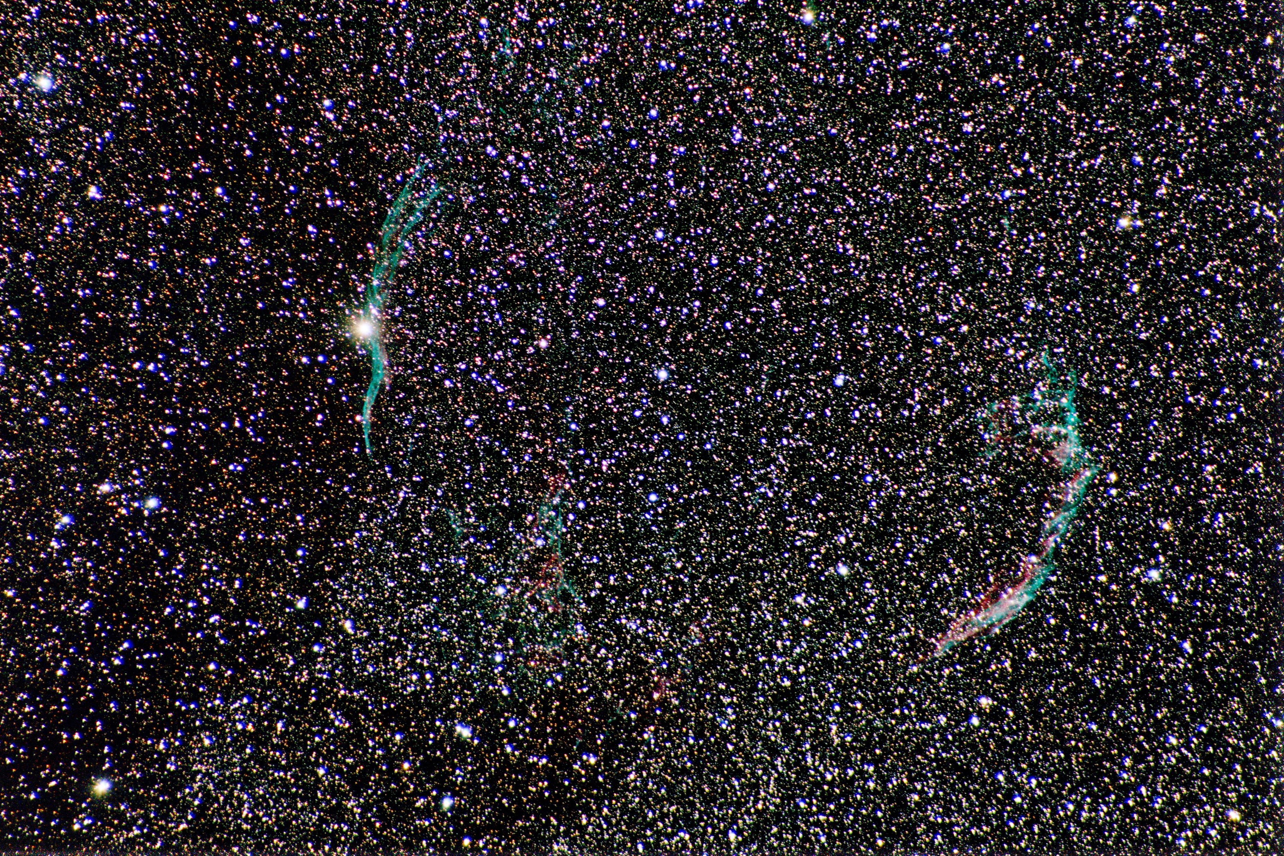
Notes:
This is my image- a Science Frame
It illustrates serendipity in an image where you don’t expect and provides the missing context from the previous image.
This is both a botched image yet one of my favorites.
Huh?
As an image of the Veil Nebula it is a failure . It simply does not show the detail I was looking for. At first I was disheartened. And then I took a closer look and wow- suddenly it’s one of my favorites.
Why? Because of the Milky way background which shows the overall context of the Veil Nebula with it’s surroundings.
What to notice: First there is some geometric distortion in the image. The veil bubble is basically a sphere- not an elliptical shape.
But look again at the Western Veil on the left. All of a sudden you do not see the reduction in star counts the previous image implied. On the left the reduction in star count extends well above and below the bubble on the left and is apparently not associated with the bubble at all. Nor do you see reduction outside the bubble above, below, or to the right of the bubble.
The interpretation here is that the Veil Bubble is silhouetted in front of an existing dust cloud and un-related to the apparent reduction in star counts.
Incidentally -never fear to hypothesize about what your images show -or don’t show. That’s at the heart of scientific inquiry- figuring out what your data is telling you.

Slide 18
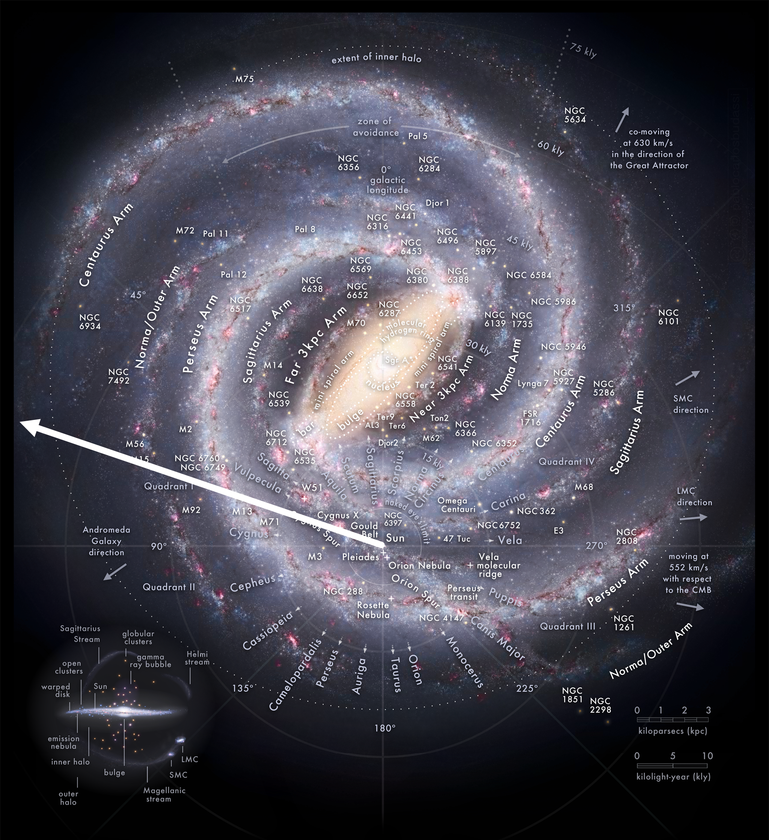
Notes:
Here’s the context.
When we take an image we are looking through three dimensions.
Here’s a view that shows what we think our own galaxy is like - a type called a Barred Spiral. When I was in college myself (late 1970’s) we did not know about that central bar and thought the Milky Way a typical grand spiral type galaxy.
When we are looking at the Veil we are looking out the backside of our own local arm toward the next one further out.
Is is my interpretation of my image this the correct interpretation? Or am I all wet?

Slide 19
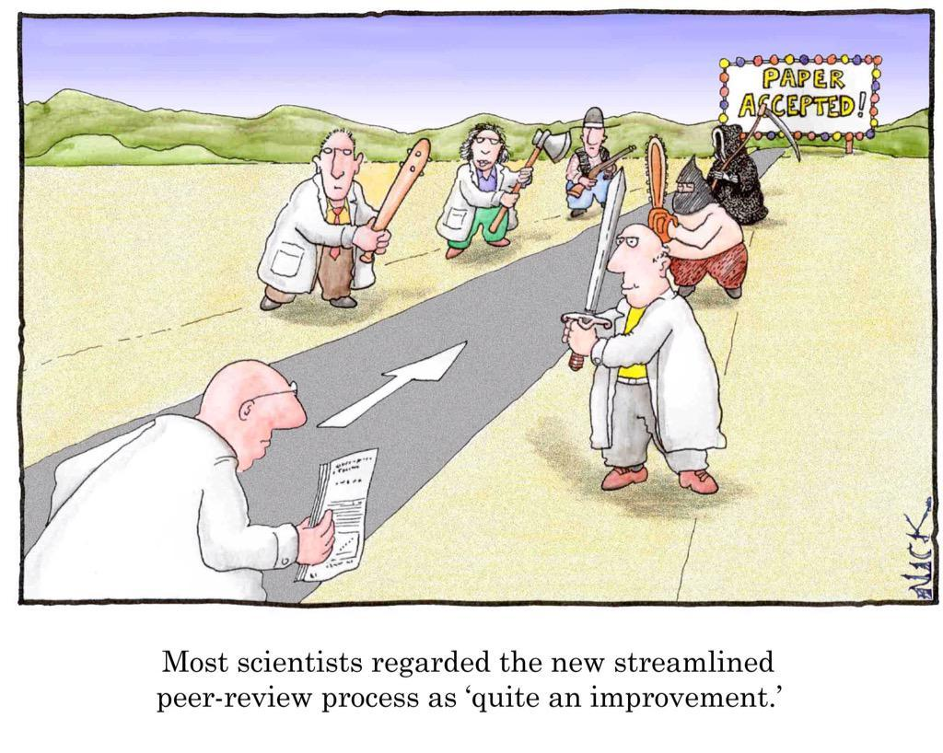
Notes:
That’s what Peer Review is for! Sometimes when you have to deal with a hostile peer reviewer you just think in exasperation- “What’s his problem already?”
But it serves a critical purpose in protecting the integrity of the scientific process.
Back in my own college days my profs always impressed on us that the Hostile Peer Reviewer is your best friend in spite of you wanting to strangle him. By taking that attitude he forces you to take a hard critical look at your own data and in the end protects both you and your Institution’s professional scientific reputation. And btw- you will have your own chance to peer review others- maybe his.

Slide 20
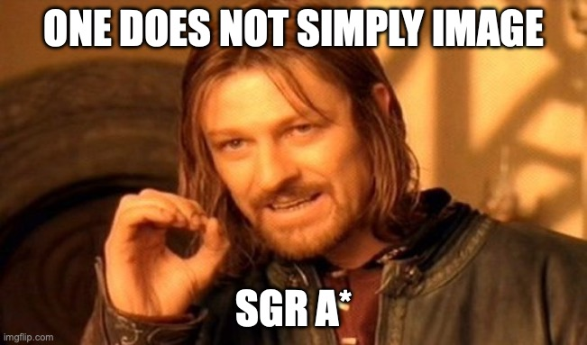
Notes:
In-house joke.
The Central Black Hole in the Milky Way is called Sgr A *- pronounced “Sagittarius A Star.”
We can see it with radio and infrared telescopes which can penetrate dust clouds but visually the center of our galaxy is forever hidden from direct view by optical instruments.
I am always being asked to point out were SGR A* is in the sky.

Slide 21
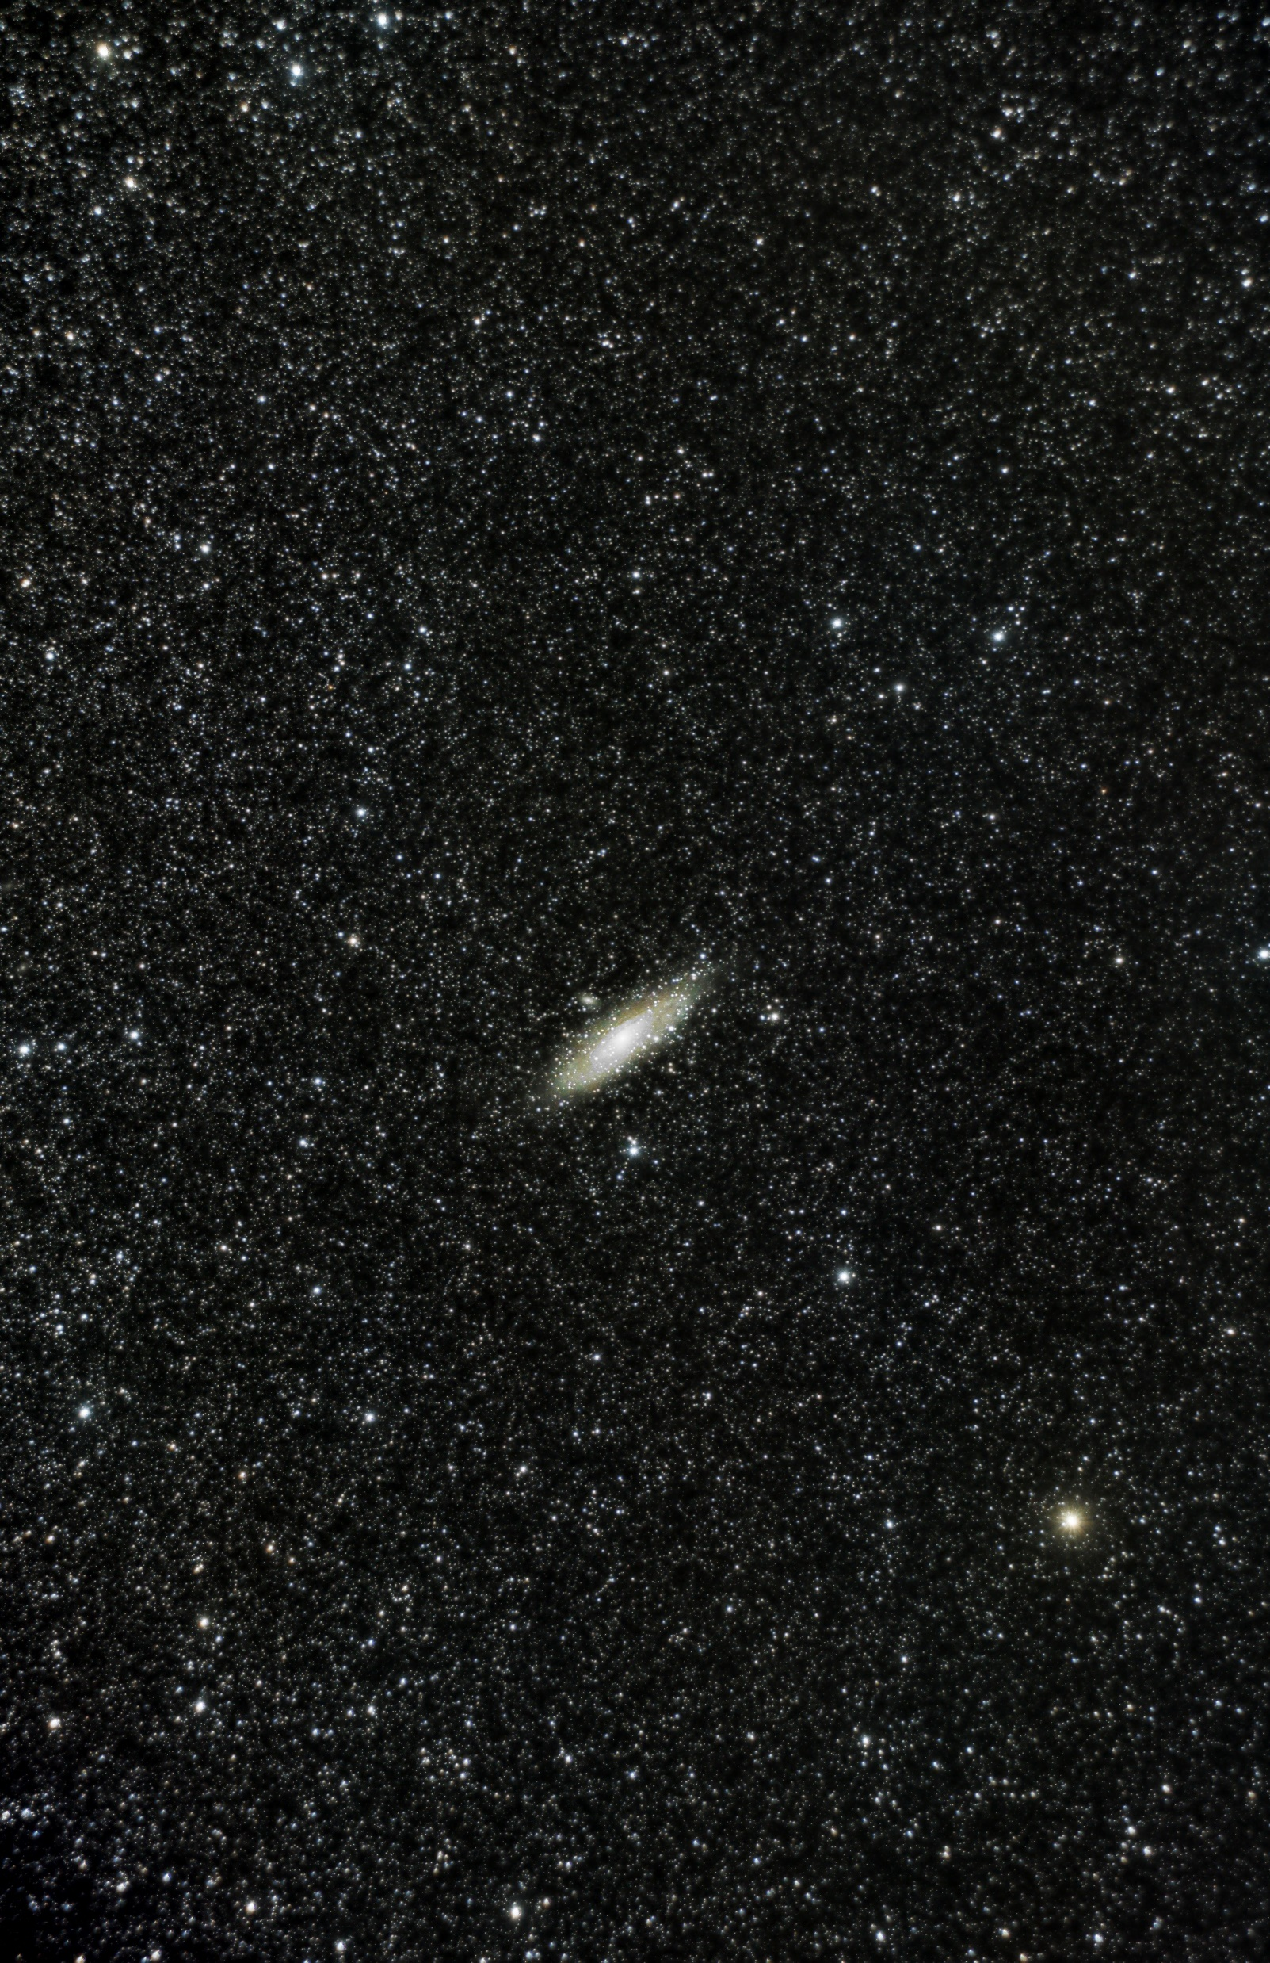
Notes:
On to our next object. We will be taking a look at a nearby neighbor- the Andromeda Galaxy M-31.We will be using various focal lengths to zero in on the galaxy.
This image was not taken through the telescope. It was taken with a typical Canon Rebel camera mounted piggyback on the telescope. The lens was a standard 50mm lens. This image shows the overall context of the galaxy seen through any number of intervening stars in our own galaxy. I don’t really think of this image as a Science Image except insofar as it shows the overall context.

Slide 22
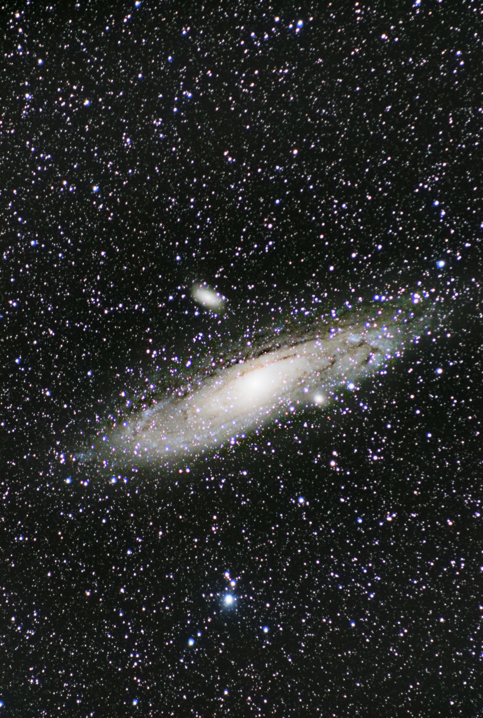
Notes:
Now we are starting to see it as you usually see it in textbooks.
The lens here was a 300 mm telephoto.
If you look closely you can see two companion galaxies.
Below to the right seemingly embedded in the galaxy. Is a small bright blob- a small elliptical galaxy called M-32
The more elliptical galaxy above is called M-110.
Our final destination in M-31 will be above the center of the galaxy toward the right at the 1:00 o’clock position.
Incidentally if you look closely you will see more detail in the spiral arms toward the top than the bottom. This is your clue that the top of the galaxy is the side toward us. Thus from our perspective we are looking slightly below the plane of the galaxy. The orientation is somewhat arbitrary. If I were to invert the image you could say we were looking from slightly above.

Slide 23
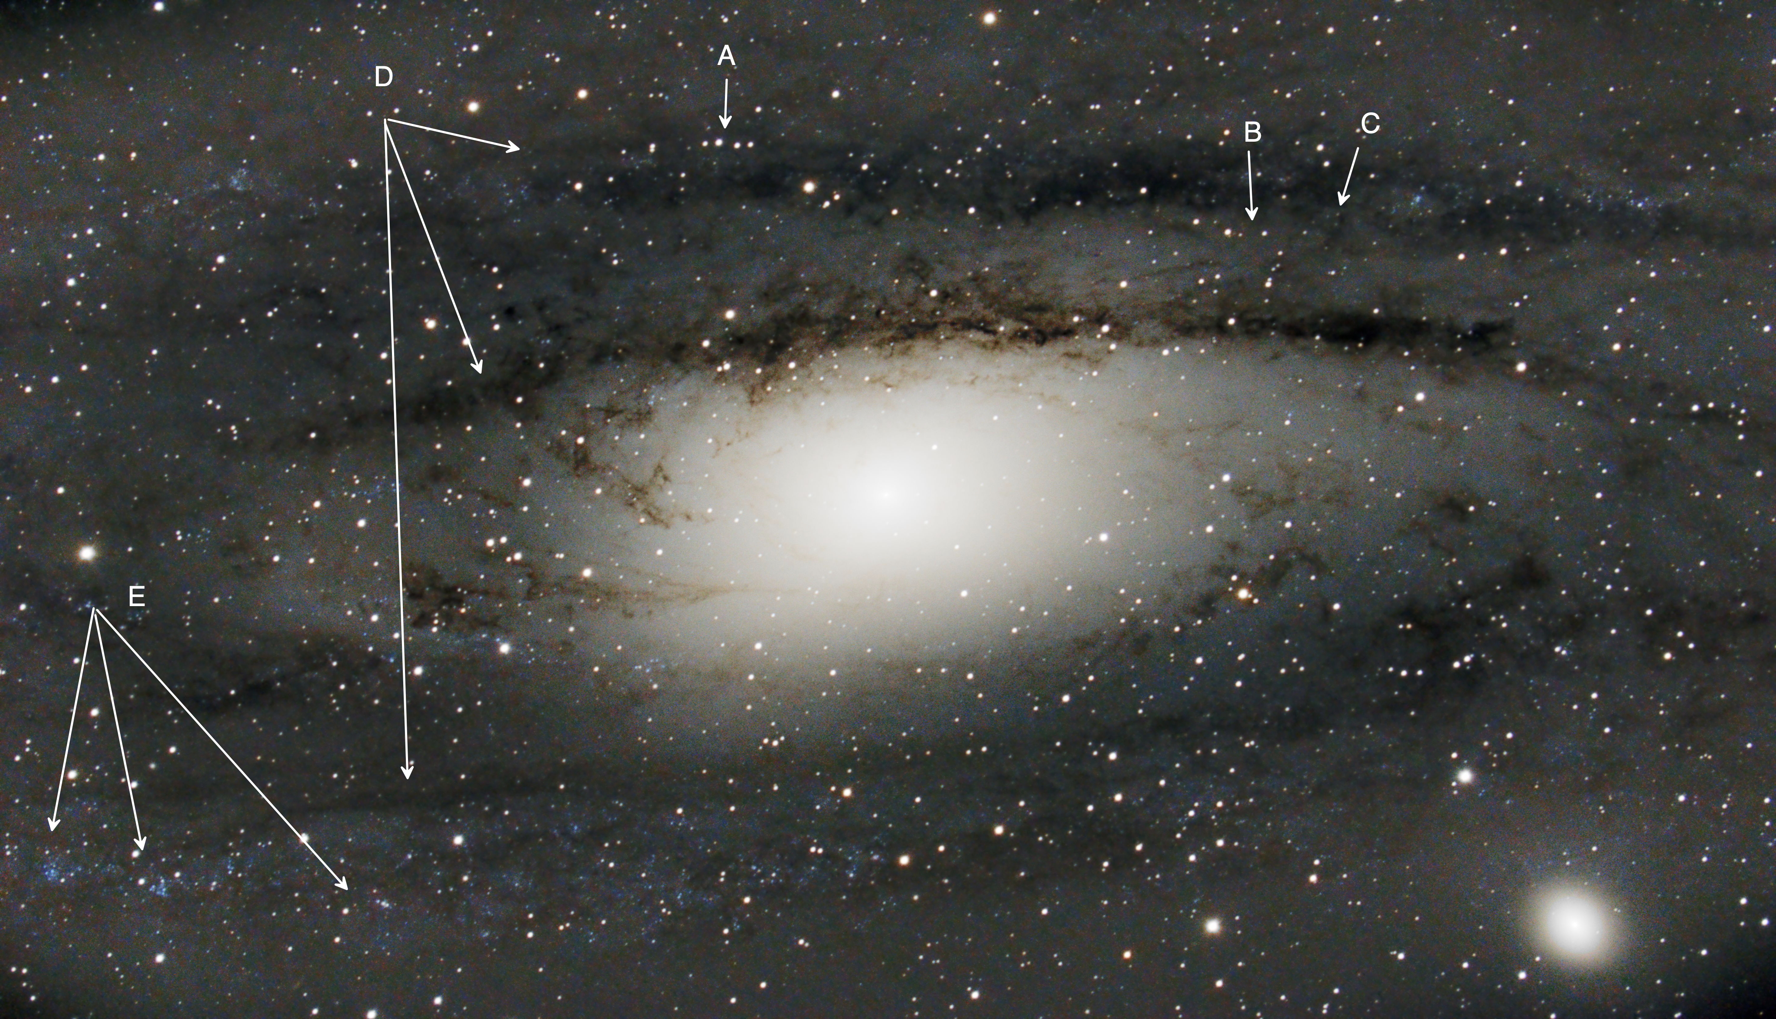
Notes:
Now we are looking through the telescope itself with a focal reducer.
The effective focal length here is 1400 mm. Essentially the telescope becomes a super telephoto lens.
Notice we can only see part of the galaxy near the core.
This is a real science image.
You get a good view of the companion galaxy M-32 on the right. The other galaxy M-110 is outside the field of view toward the above left.
Note the line of four stars here. This is a reference point for us to get around the galaxy.
Pointer star pattern. Note this star pattern. It points toward our ultimate target.
C. This will be our ultimate destination which I call the Fishhook.
D. Dust Lanes- these dark lanes are characteristic of large spiral galaxies. If you look at our own Milky Way in the night sky you will see this for yourself.
Our problem on Earth is that we do not see the full context of the dust lanes as we are seeing them from the inside. Im M-31 we see their real context.
E. Most of the stars in this image are foreground stars in our own galaxy . But notice those blue groups and how they seem top follow the spiral arms. You are now getting your first look at actual stars inside M-31.
btw- Remember that old Star Wars Phrase -“A Long Time Ago In A Galaxy Far Away”. That’s what you have here. M-31 is roughly 2.5 million light years distant. That means you are not seeing the galaxy as it is today but as it was 2.5 million years ago. As an interesting side note- Look up in your geology texts what was happening here on Earth when the light we see today started on it’s long journey.

Slide 24
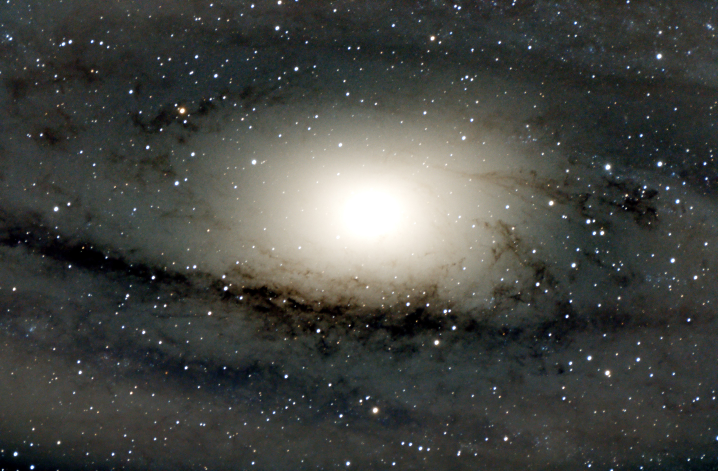
Notes:
This image was taken at prime focus- 2000 mm f\10.
Look for the guideposts from the previous image

Slide 25
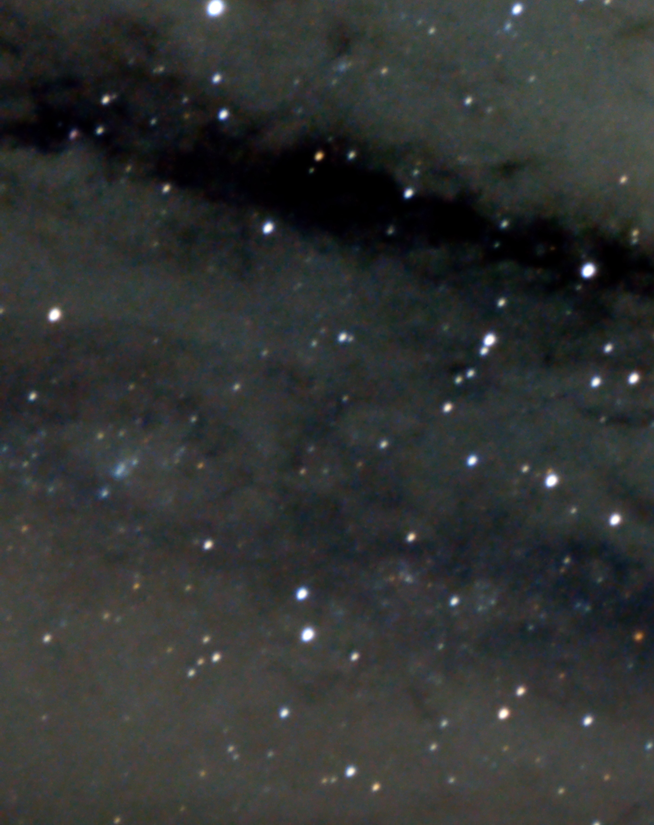
Notes:
Her’s a close-up of the previous image. You should now be able to see the fishhook. Look at the blue star just past the hook.
This is our destination. This star has been called “The Star That Changed The Universe” .
This is the Cepheid Variable that Edwin Hubble used to measure the distance to M 31. It established for all time that the Spiral nebulae were independent galaxies and not part of the Milky Way.
We knew distances were vast but this measurement gave us an inkling of just how mind numbingly big the Universe really is.

Slide 26
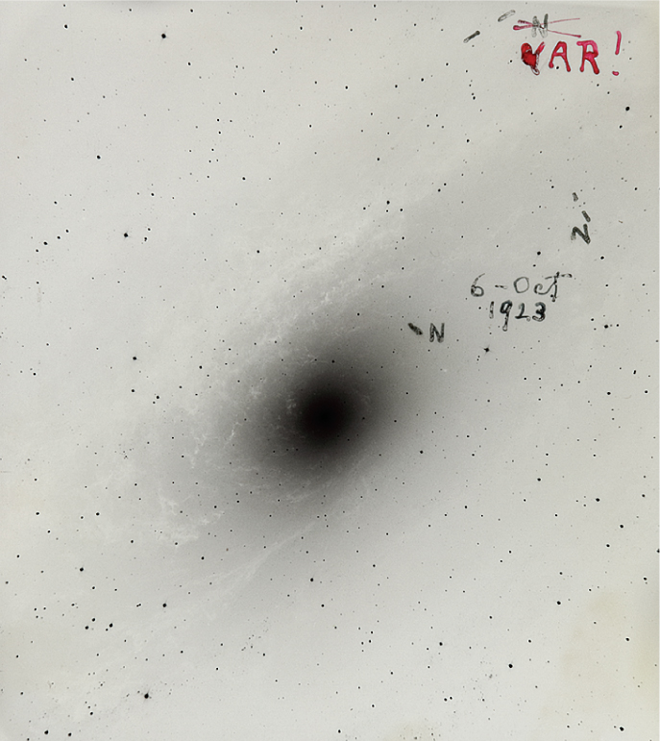
Notes:
Here is one of the Harvard glass plates taken at the 100 “ Hooker telescope at Mt. Wilson in 1923.
Note our guideposts from my images.

Slide 27
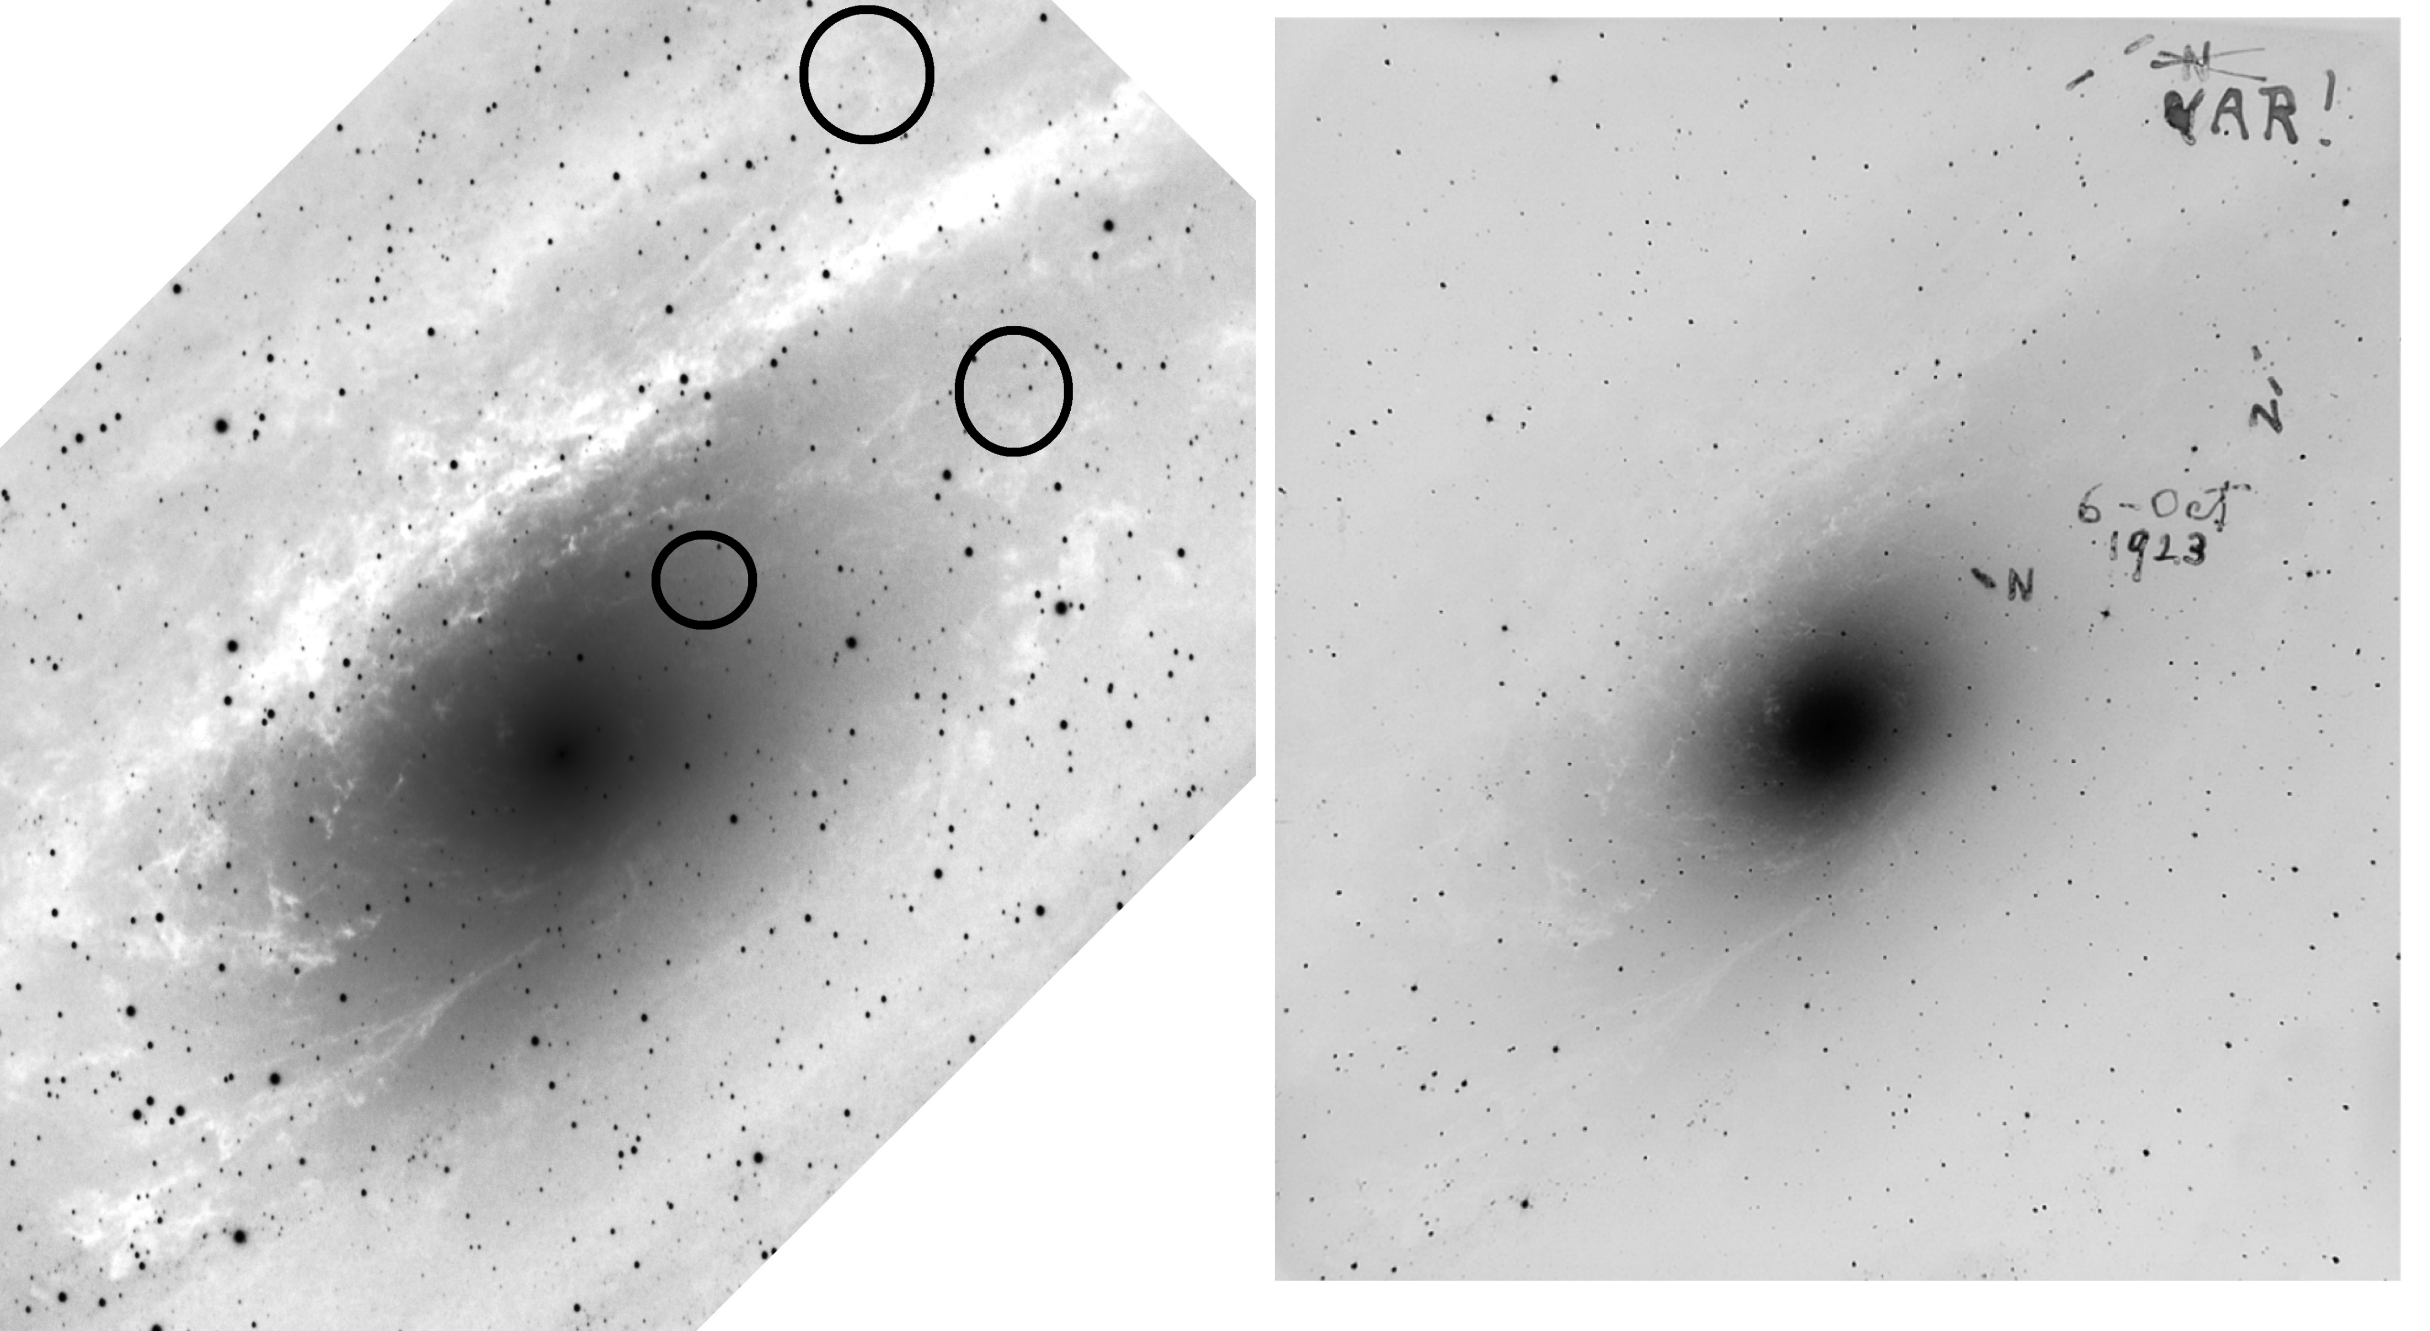
Notes:
The image on the left is mine. And is an example of a light image processed for use as a science image to study. I turned the image into a back and white image then inverted it into a negative. That allows me to directly compare the two images.
Look at the star patterns of the ones labeled as Nova (N).
Then look a the circles in my image. You will notice missing stars in mine. I have documented a change in the appearance of M-31 between 1923 and 2018 when this image was taken. In actuality the stars are not gone but have simply faded below visibility. They are still there but their light merely contributes to the background amorphous glow.

Slide 28
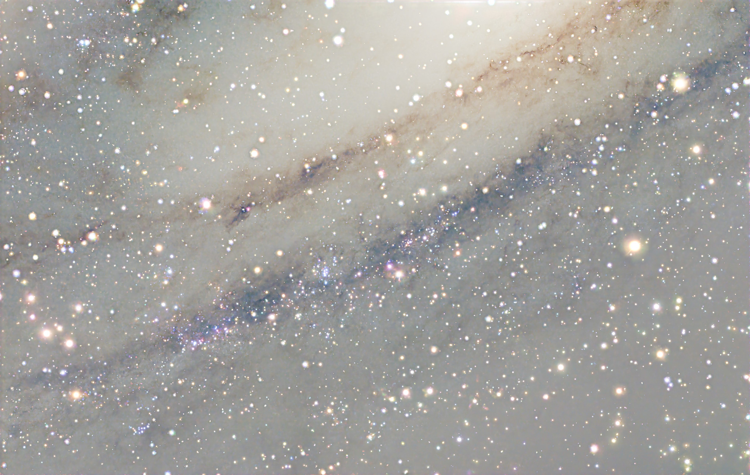
Notes:
Probably my deepest image of M-31 to date- taken in 2025

Slide 29
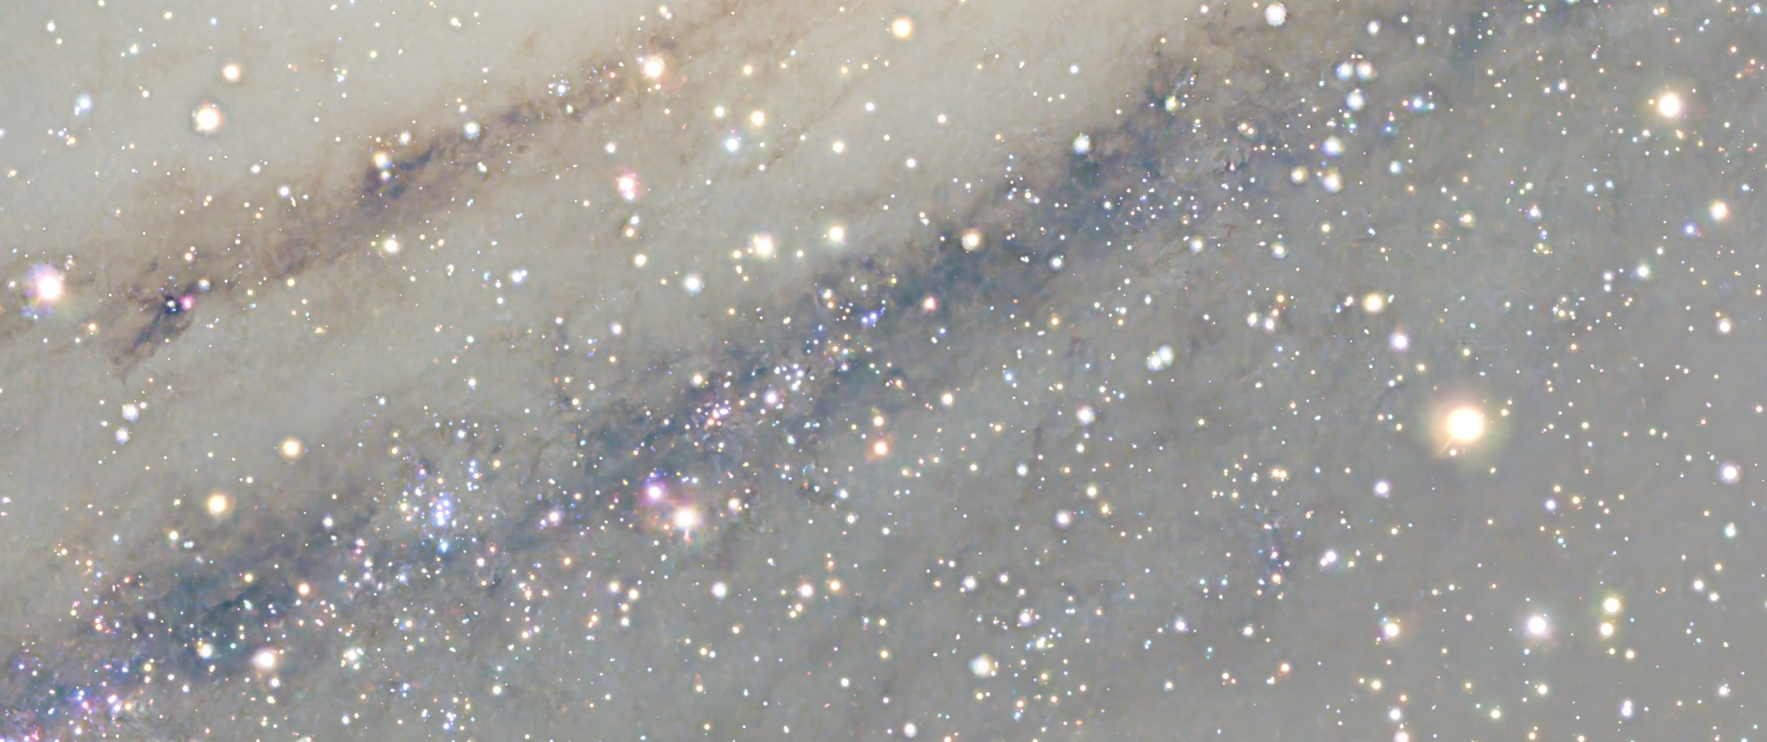
Notes:
Here’s close up. Note the fishhook containing our old friend Hubble-V-1 just past the hook.
Nowadays when I see an image of M-31 I judge the image by whether I can see any of our new friends in M-31. The four stars, the weirdo star pointer, the fishhook, and Blue Associations.

Slide 30
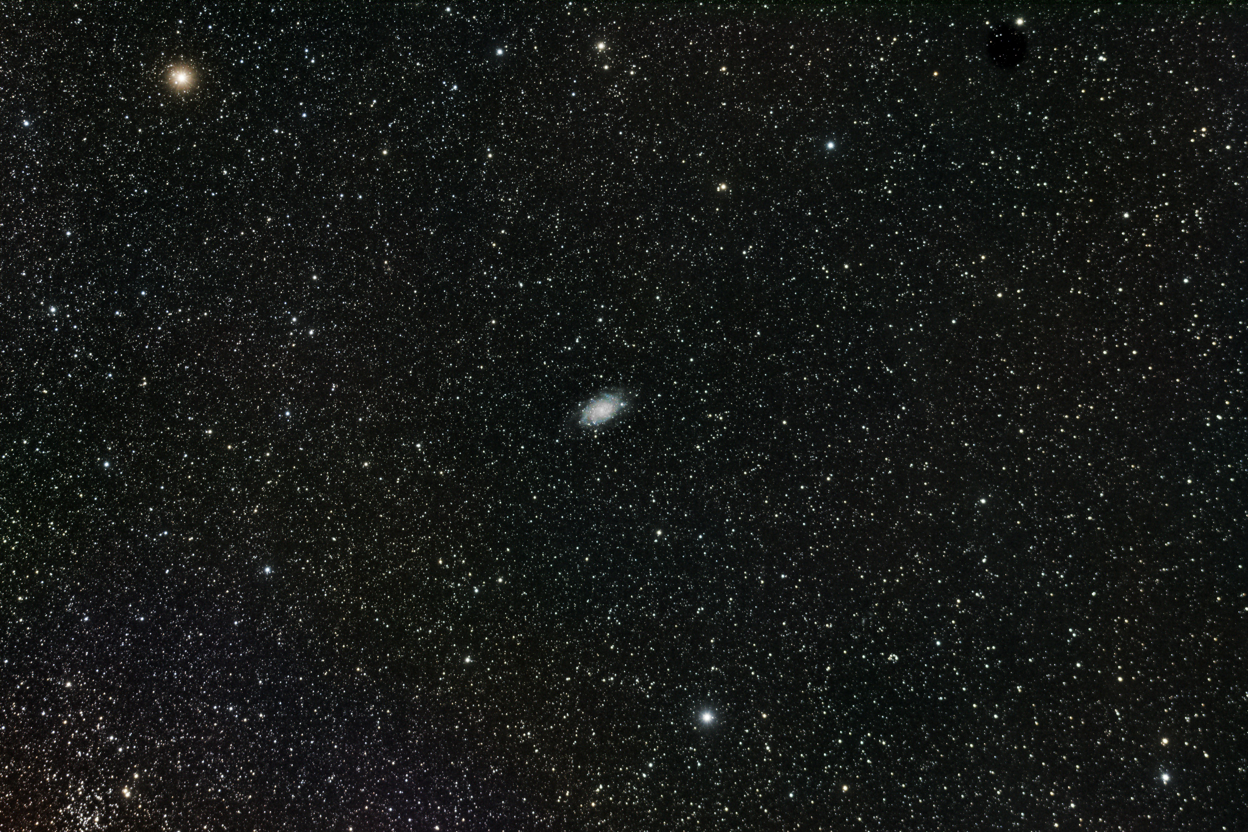
Notes:
Now we are going to do the same for M-33.
This image was taken with the 50mm lens. Notice Mirach -the star at upper left. At our star parties ask us to show you this star. Right next to it is a small elliptical galaxy NGC 404.
M-33 shows a hint of spiral pattern.

Slide 31
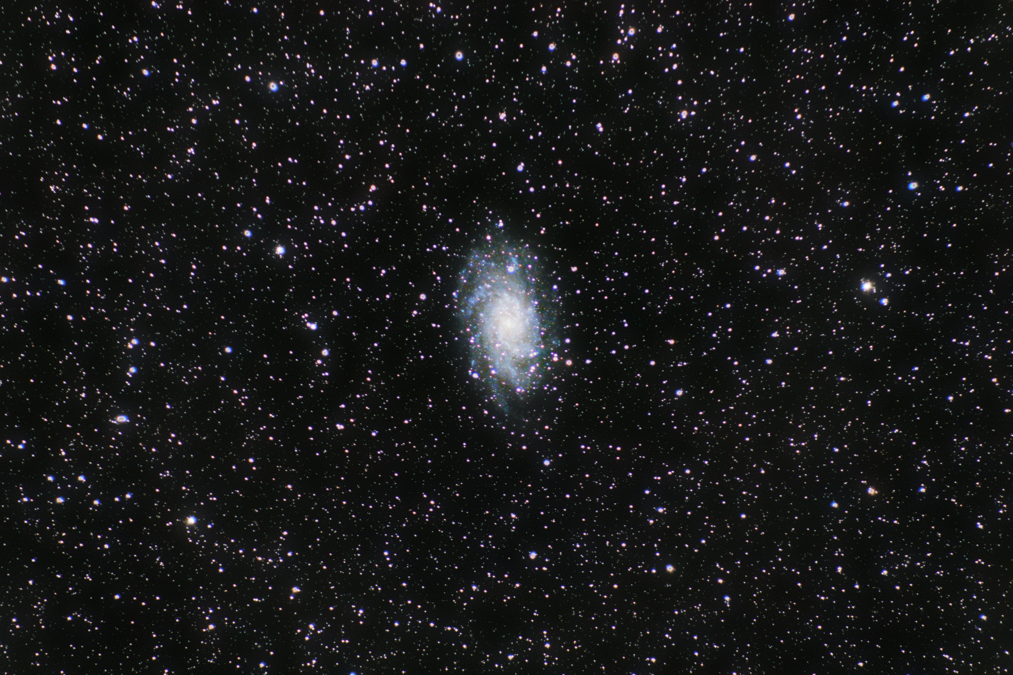
Notes:
The spiral pattern of the galaxy appears.
This image was taken with a 300 mm telephoto.

Slide 32
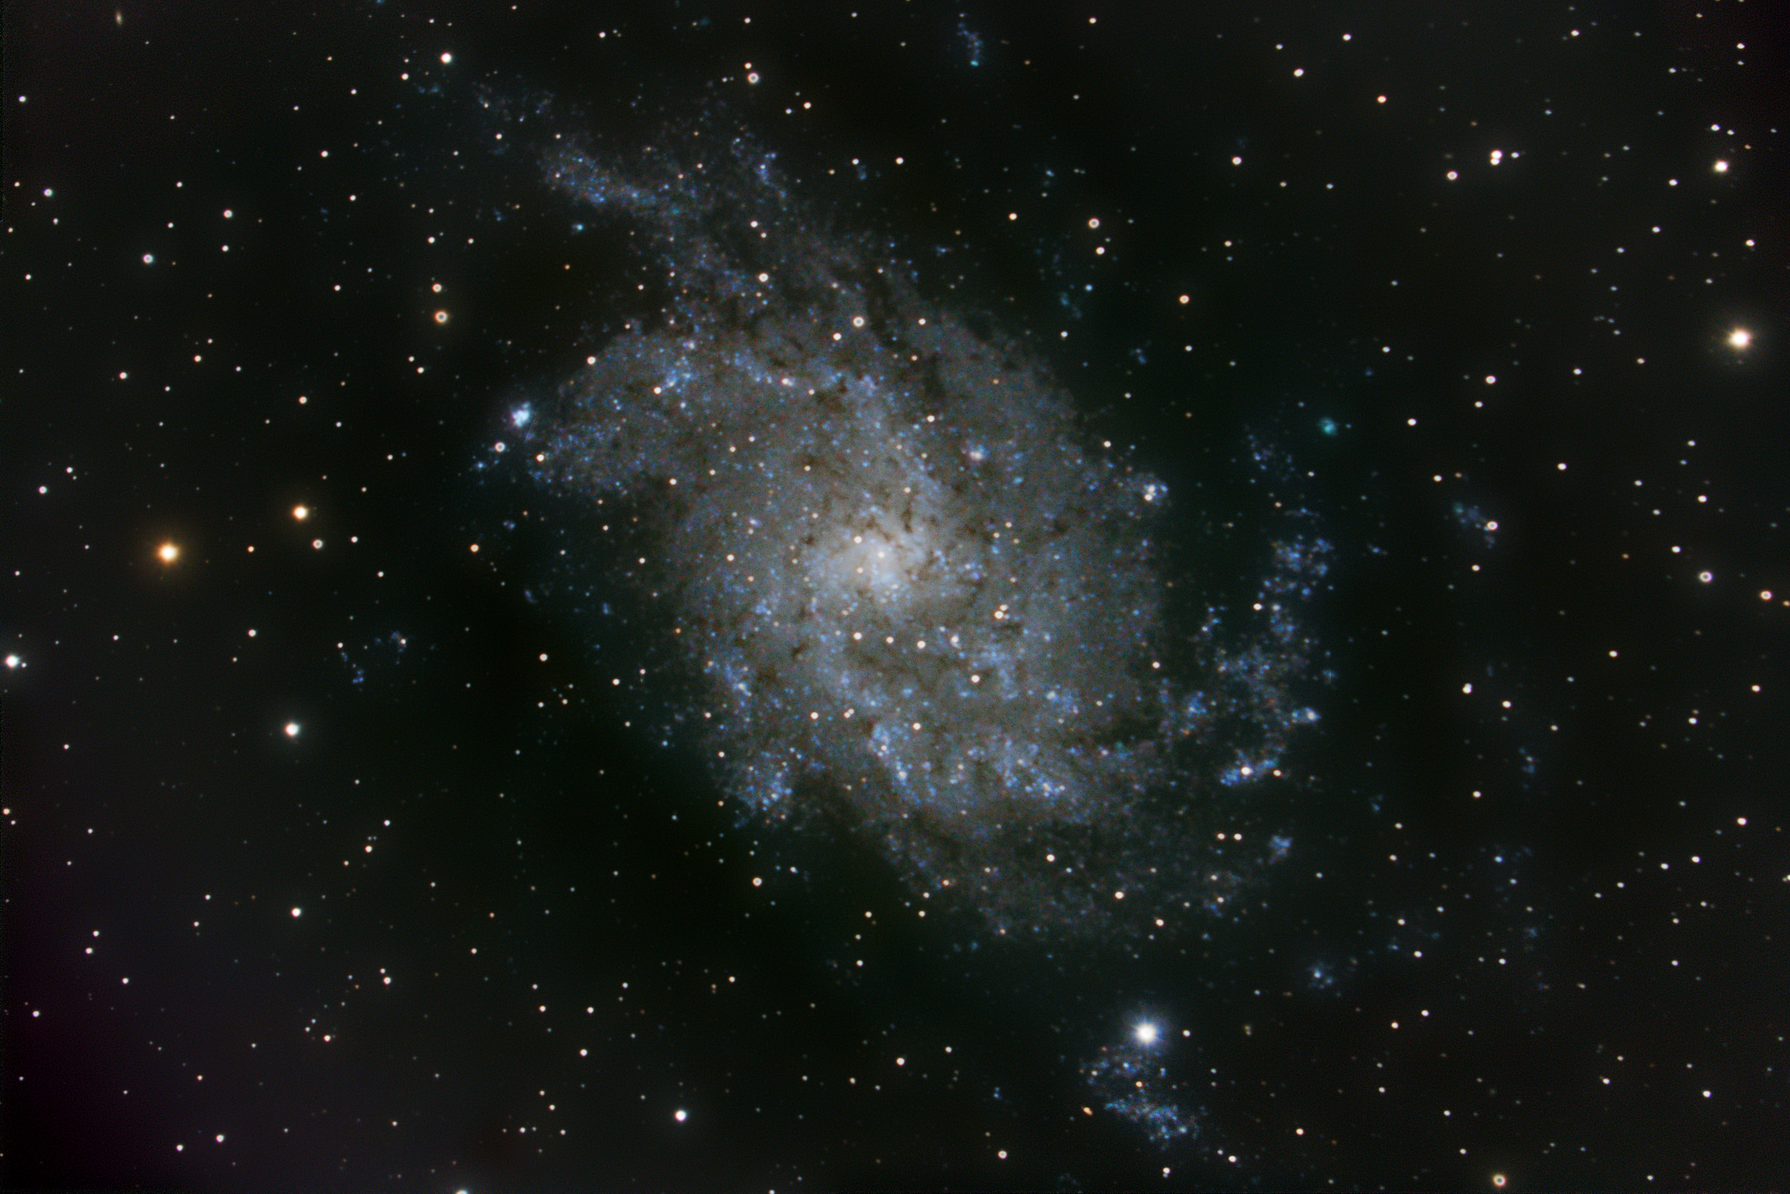
Notes:
Here we are using the focal reducer. 1400 mm f/7
Wow- Spiral Arms.

Slide 33
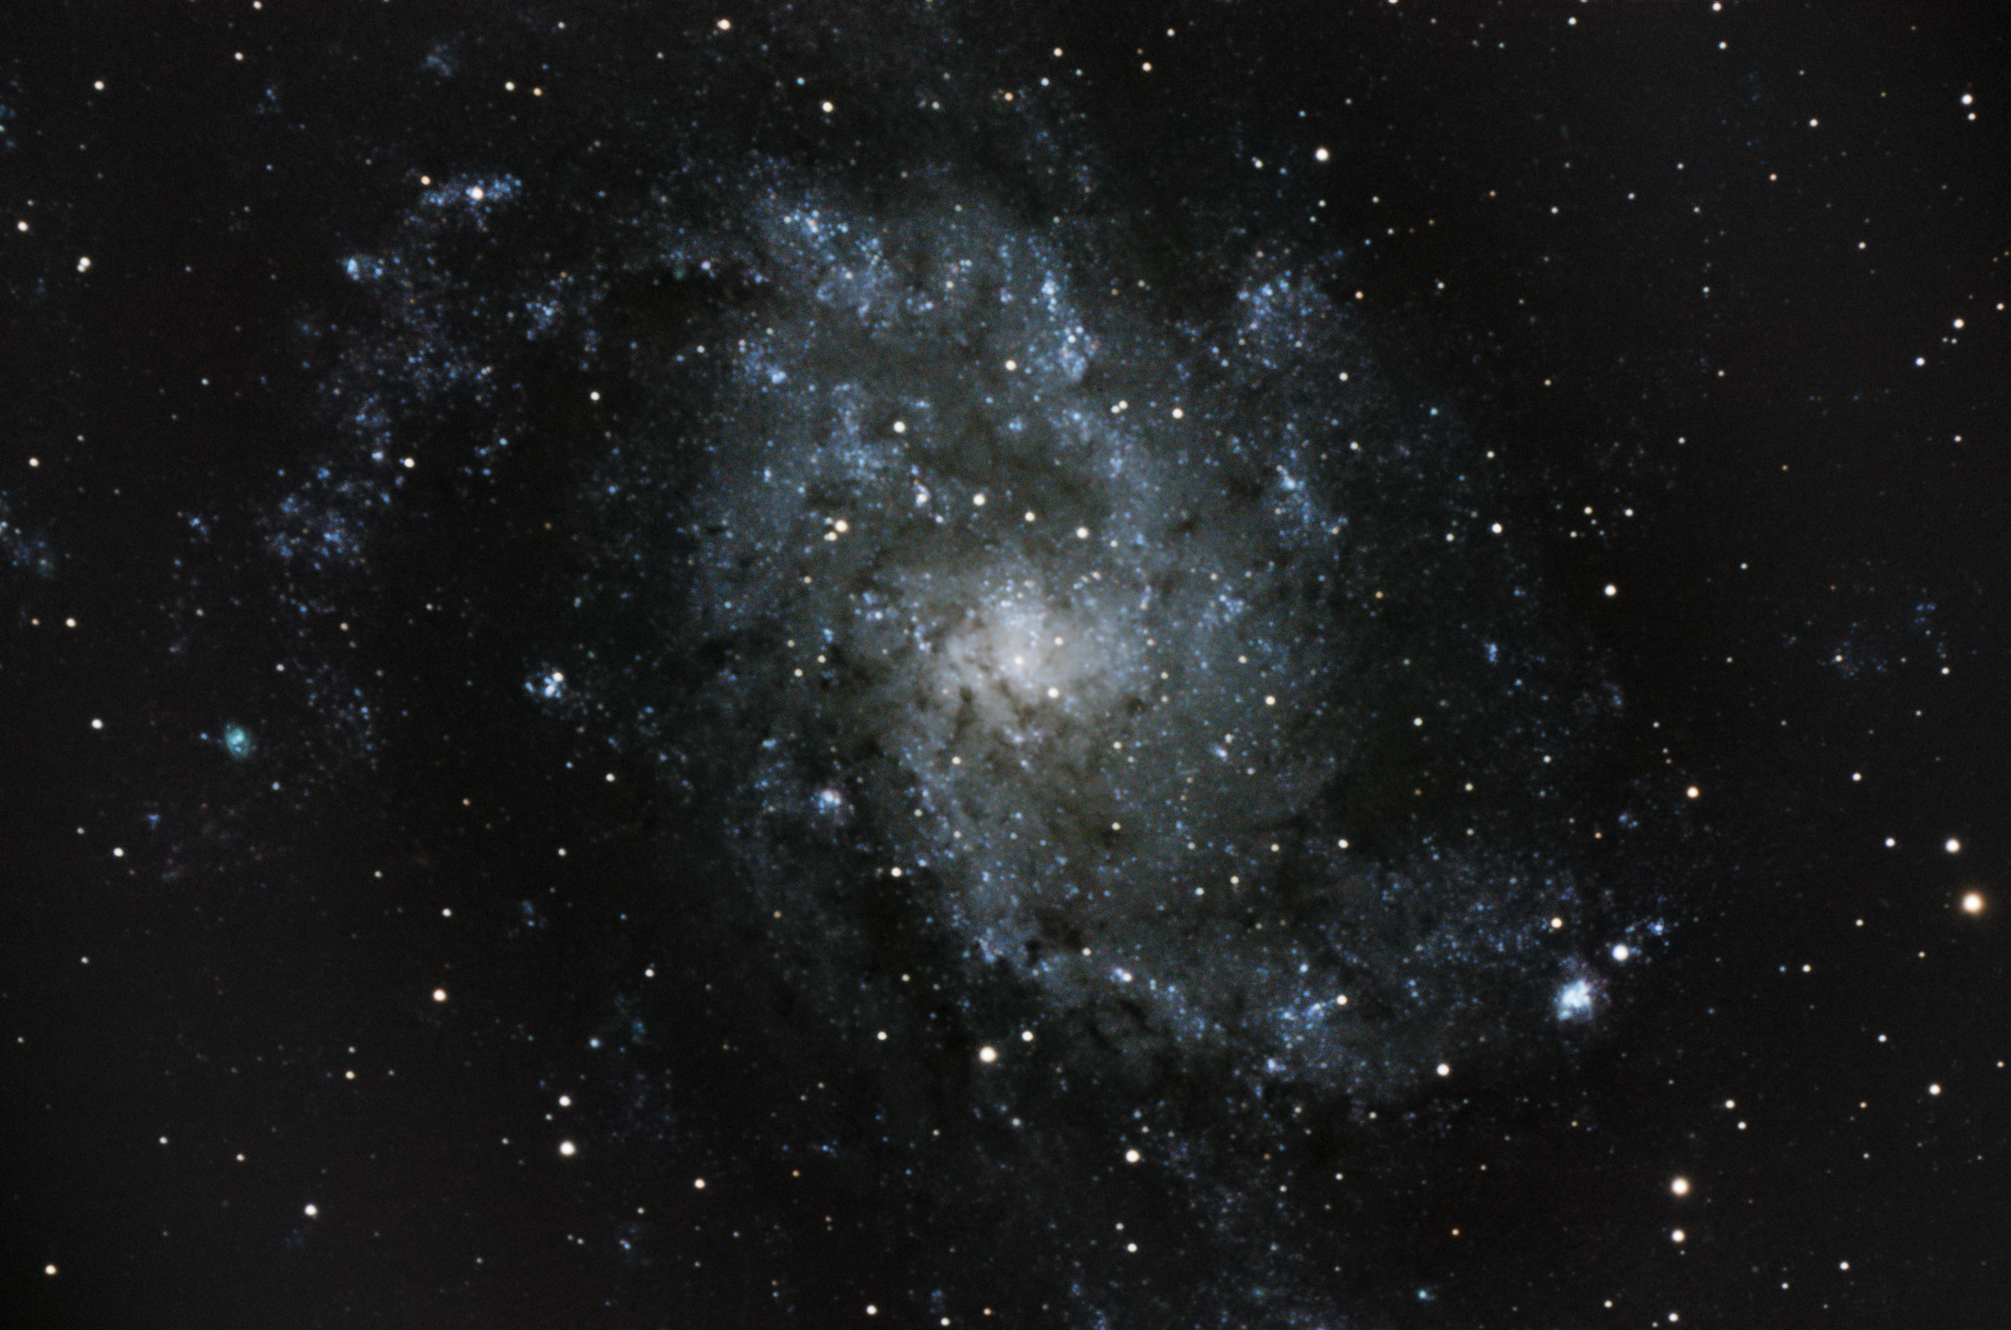
Notes:
Another view- this time at prime focus. 2000 mm f/10
Take a look just to the left of that line of stars across the middle.

Slide 34
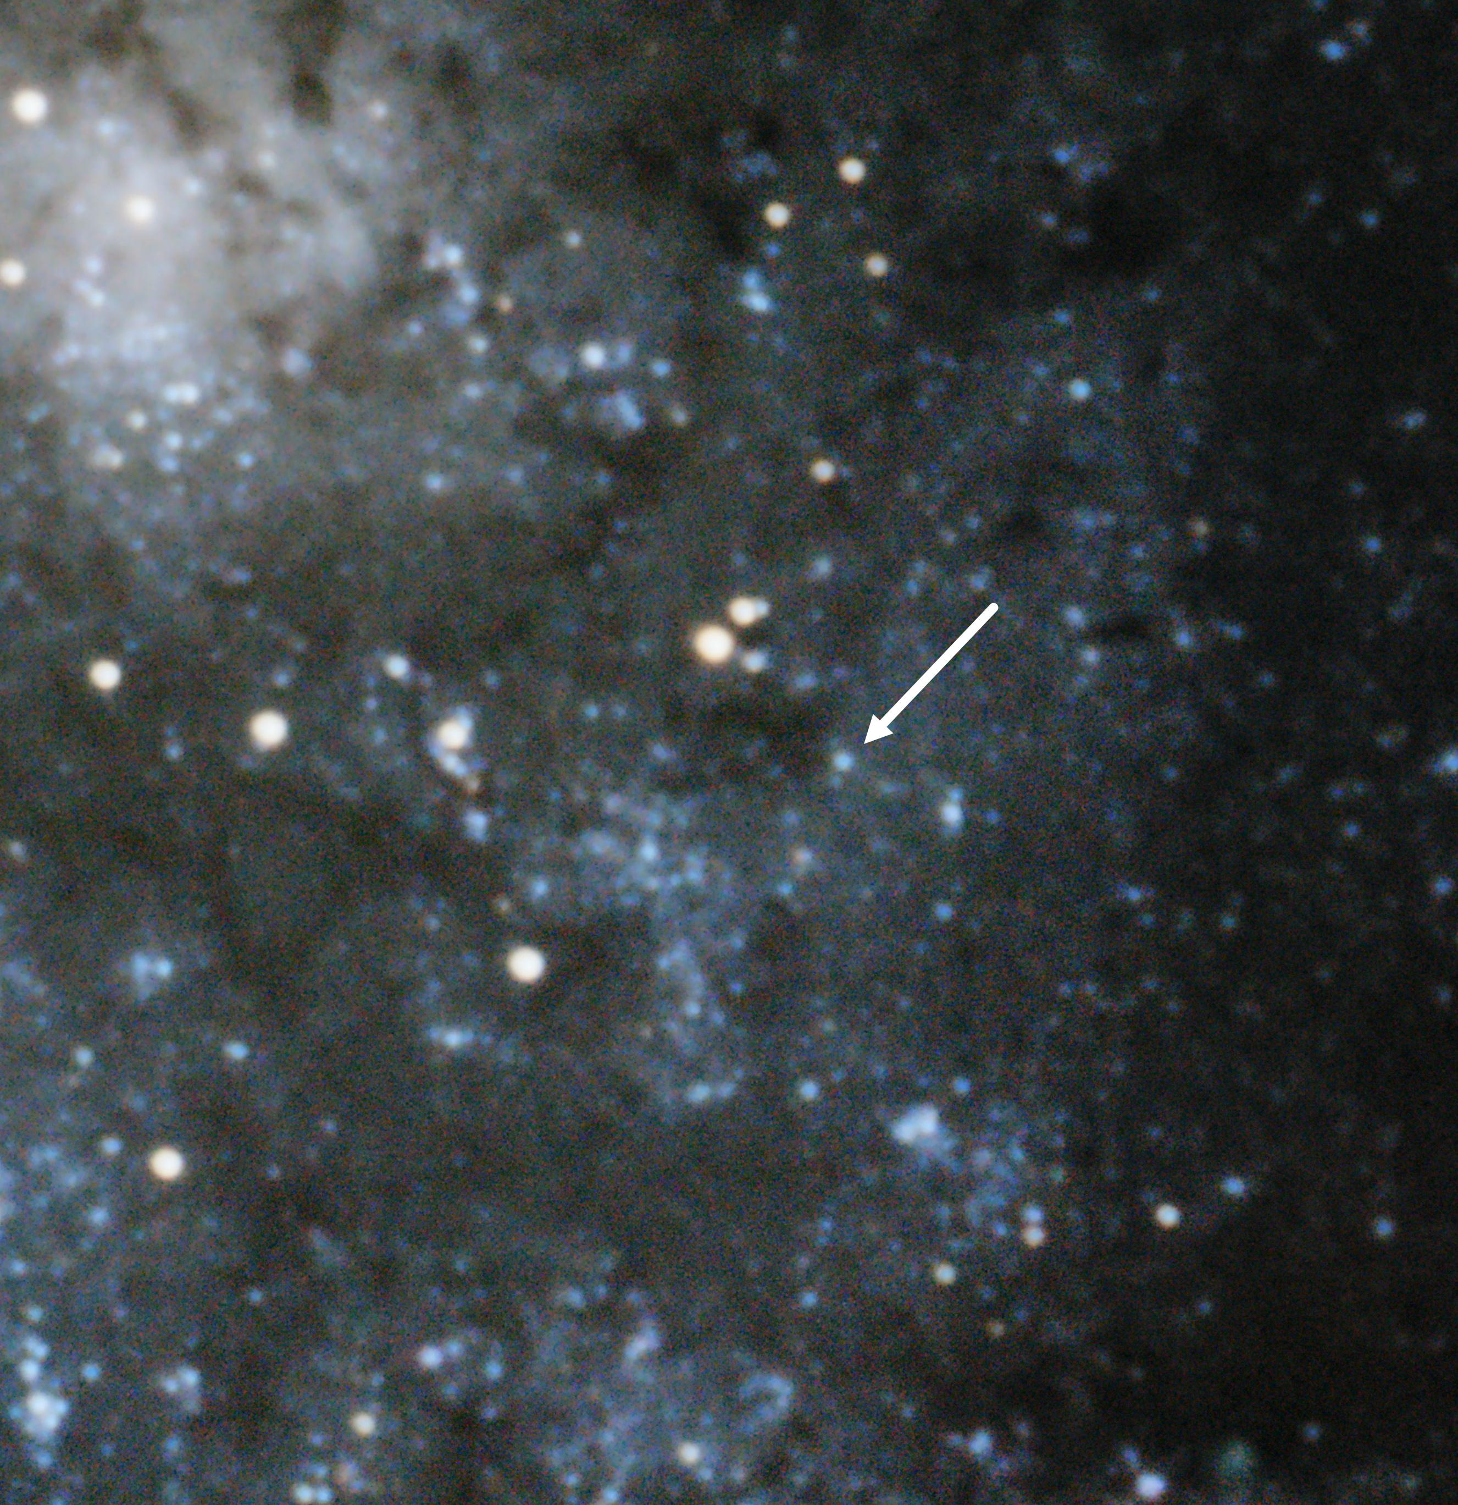
Notes:
Here is the star M33-013406.63
For some years this was believed to be the brightest and most massive Blue Supergiant in M-33.
A Luminous Blue Variable- this star shows evidence of mass loss and is believed to be near the point where radiation pressure is actually removing mass from the star.
There are however some indications this is a binary star which would greatly affect the interpretation of this system. School is still out on the final story here

Slide 35
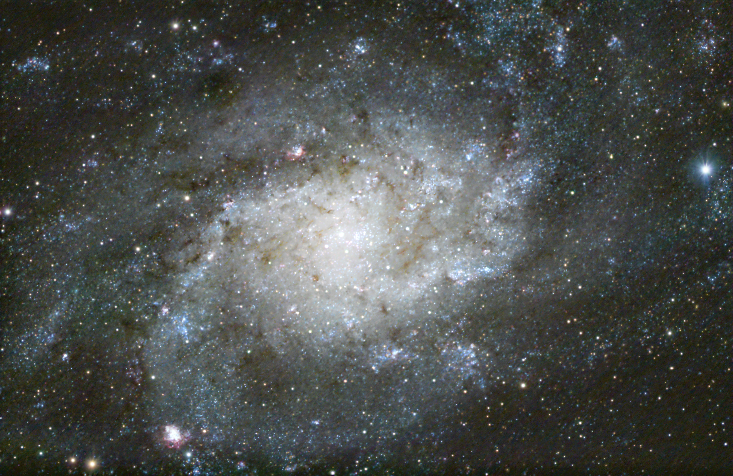
Notes:
Taken in 2024 this is my deepest image of m-33 to date. Numerous individual supergiants are seen.

Slide 36
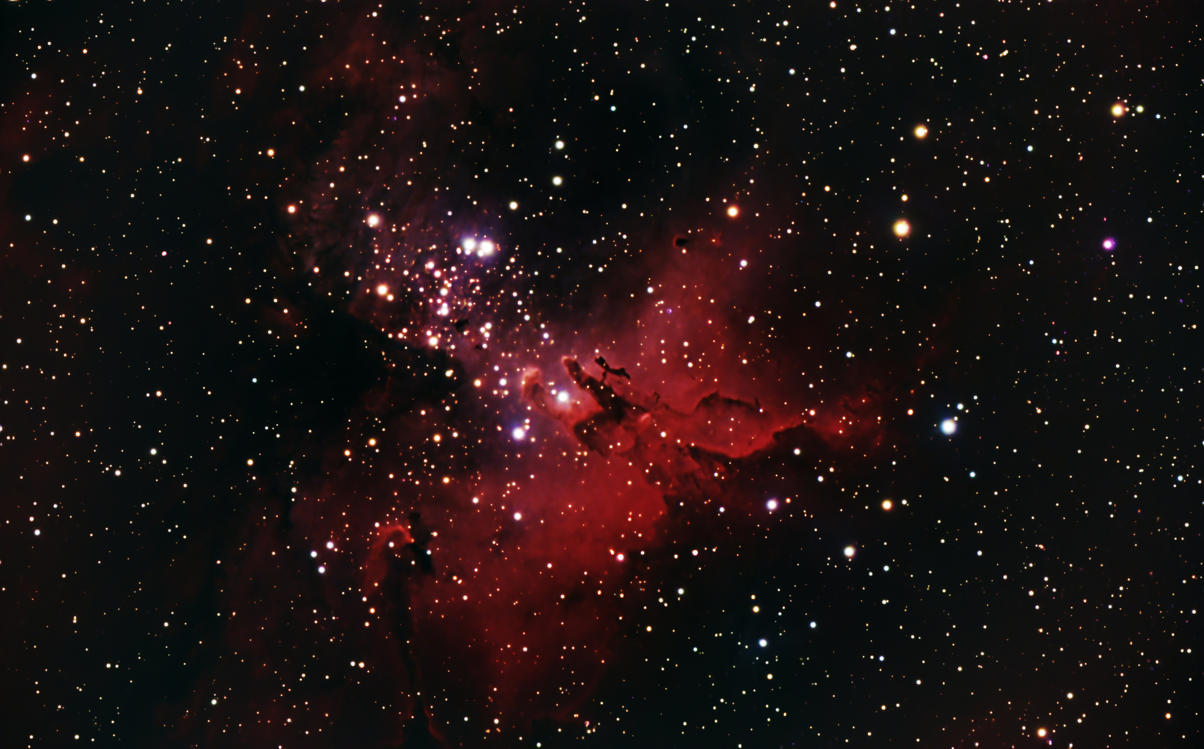
Notes:
Here’s the Star Queen Nebula in M 16- also called the Eagle Nebula. You probably recognize it from the Hubble image “Pillars of Creation”
Remember when i said I process Nebula separately from stars?
In my original image I had some green and blue. But I wanted to see just how much red sensitivity I have in my ZWO camera. My Canon DSLR removes almost all the reds so I rarely see hydrogen emission in images taken with that camera.
But the ZWO camera retains the sensitivity.
I went back and removed the blue and green color channels and just kept the red.
But I did not remove the colors from the stars. They were mostly saturated anyway so little color appears.

Slide 37
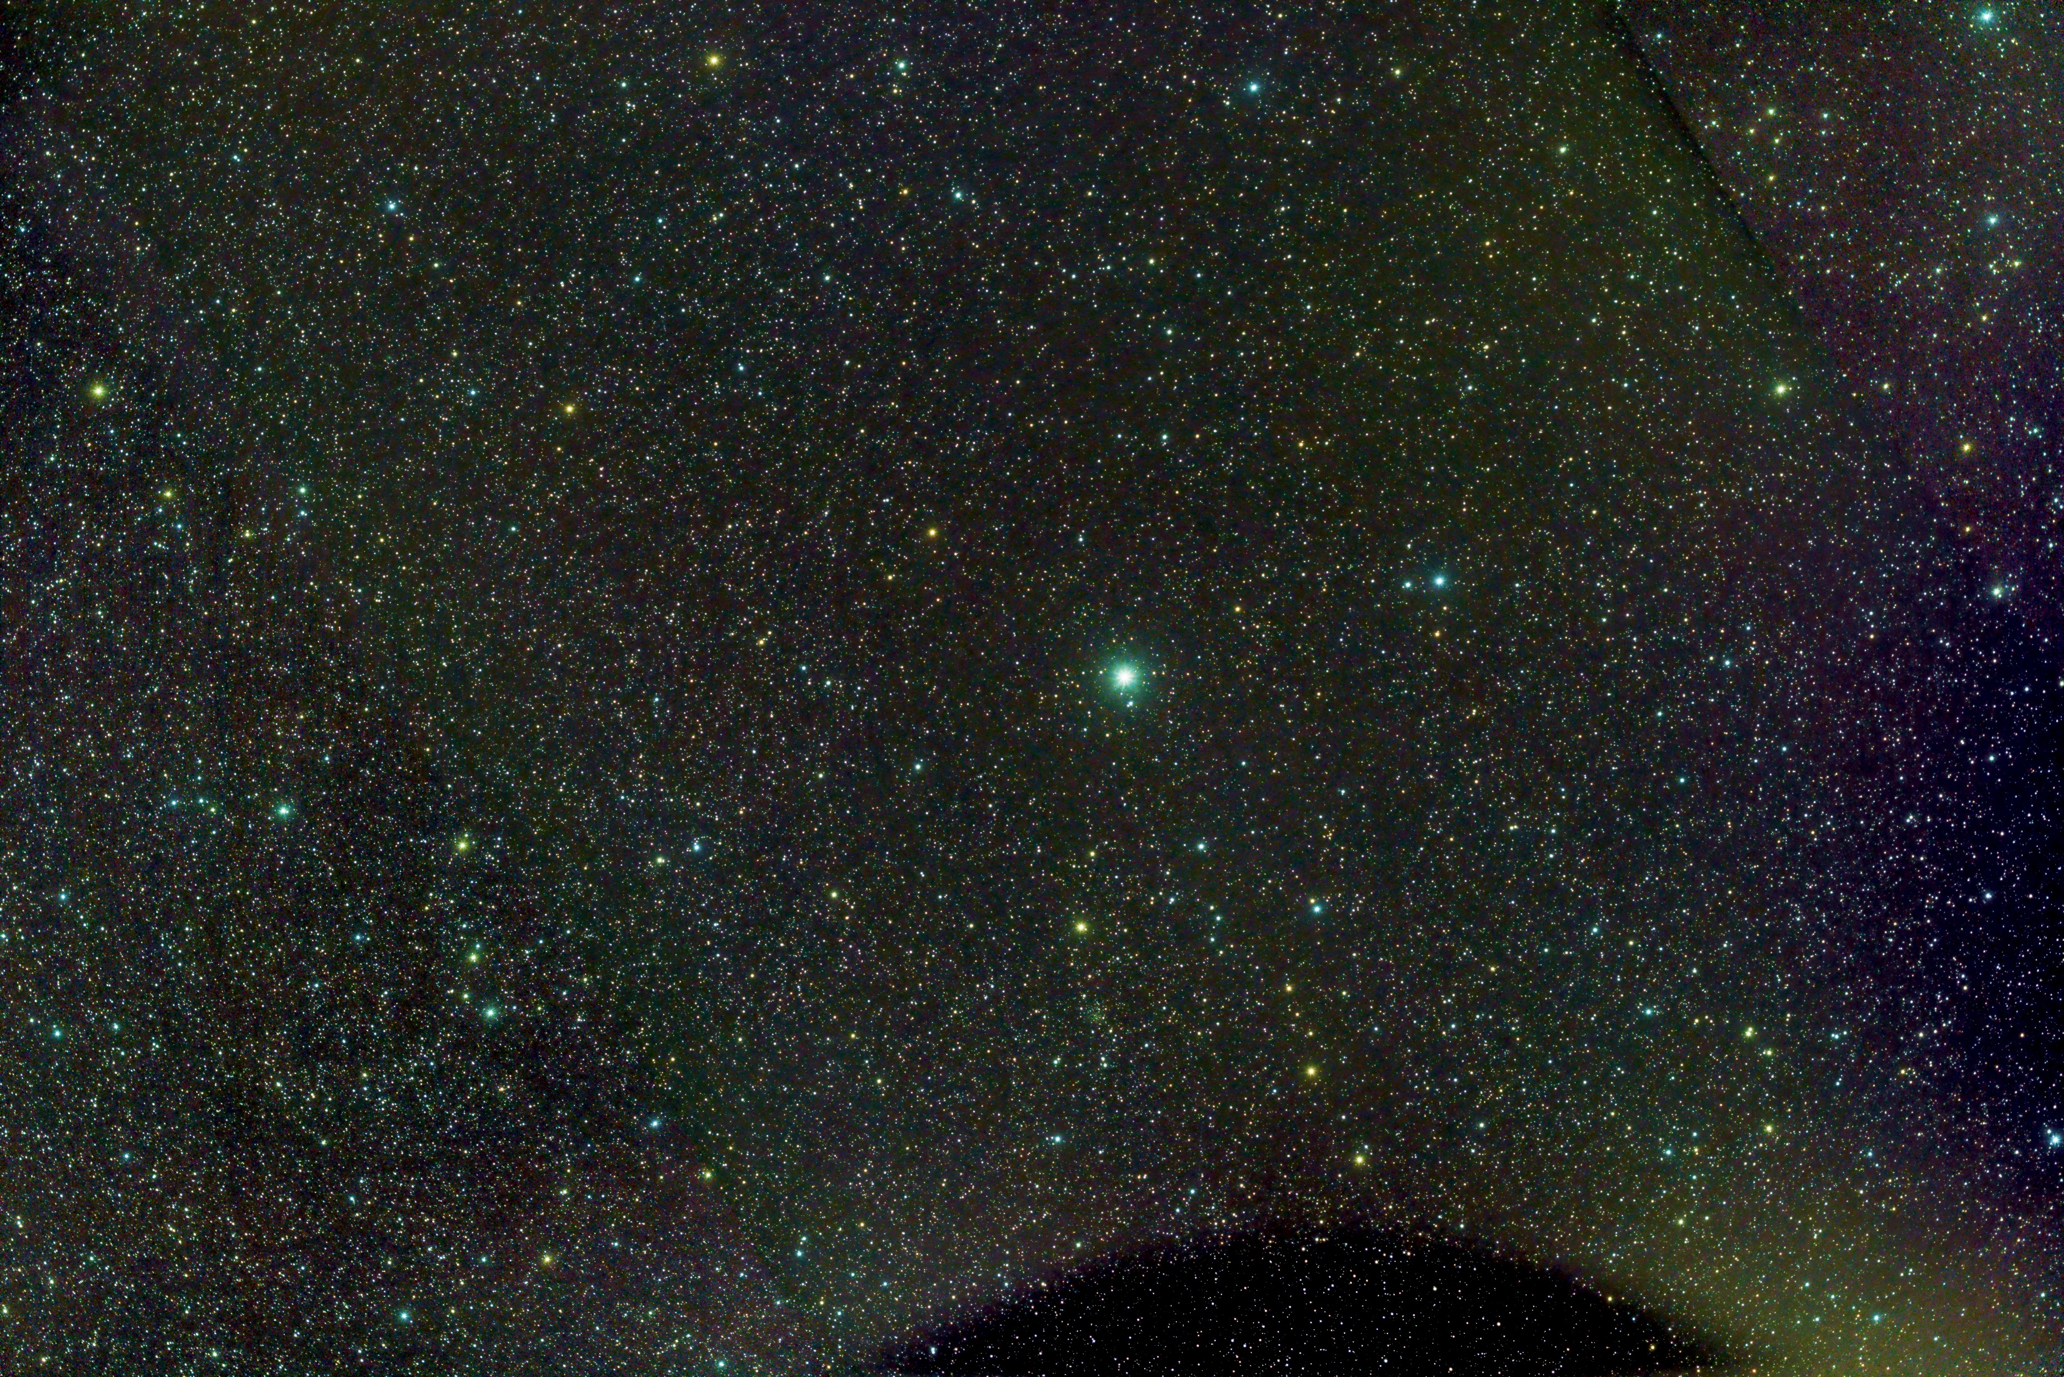
Notes:
Here’s an example of an ugly science image. The colors simply suck.
Technically this is Polaris the north Star.
But my target was the Polaris Flare Dark nebula- some dust cloud sin the Milky Way.
It looks like there are some barely visible signs of the nebula toward the top left but I can’t be certain whether it’s real or imaging artifact from grossly over-stretching and saturating the colors

Slide 38
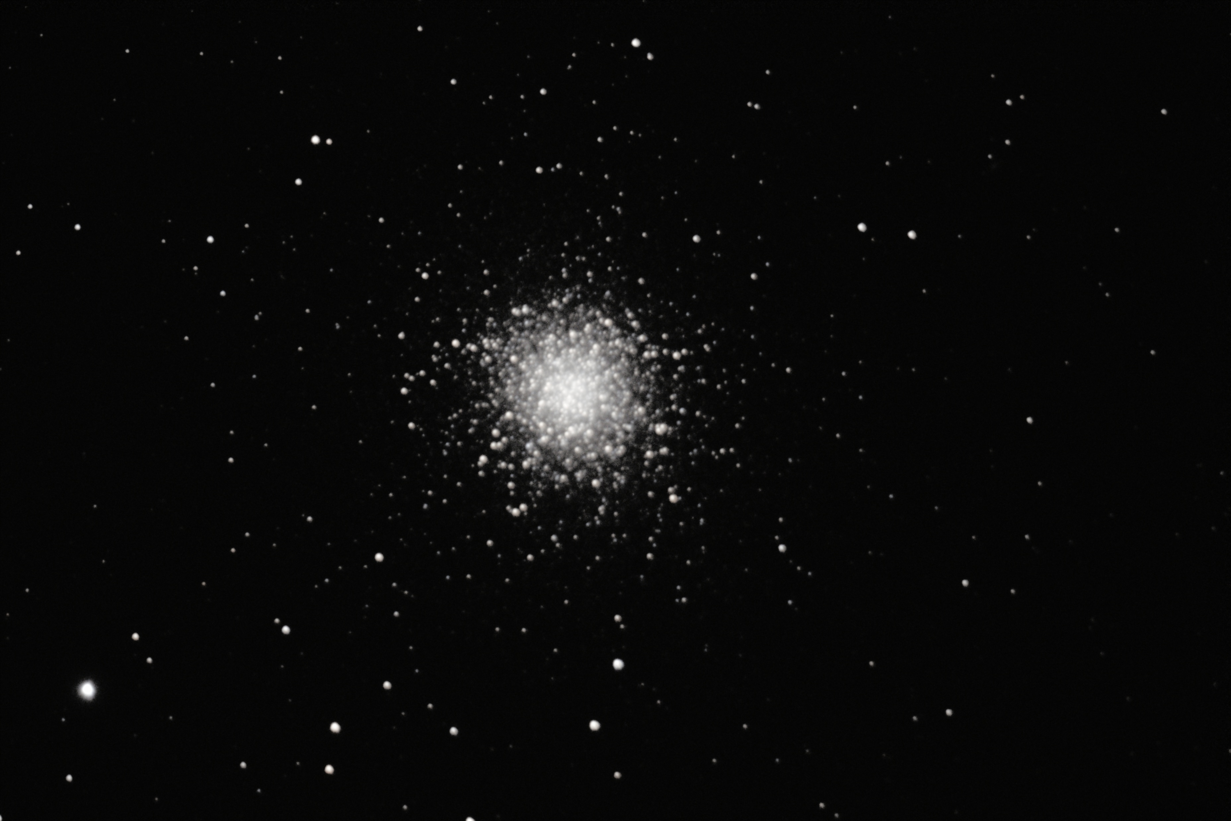
Notes:
Here’s an older image of M-13. Notice the lack of star colors from saturation.

Slide 39
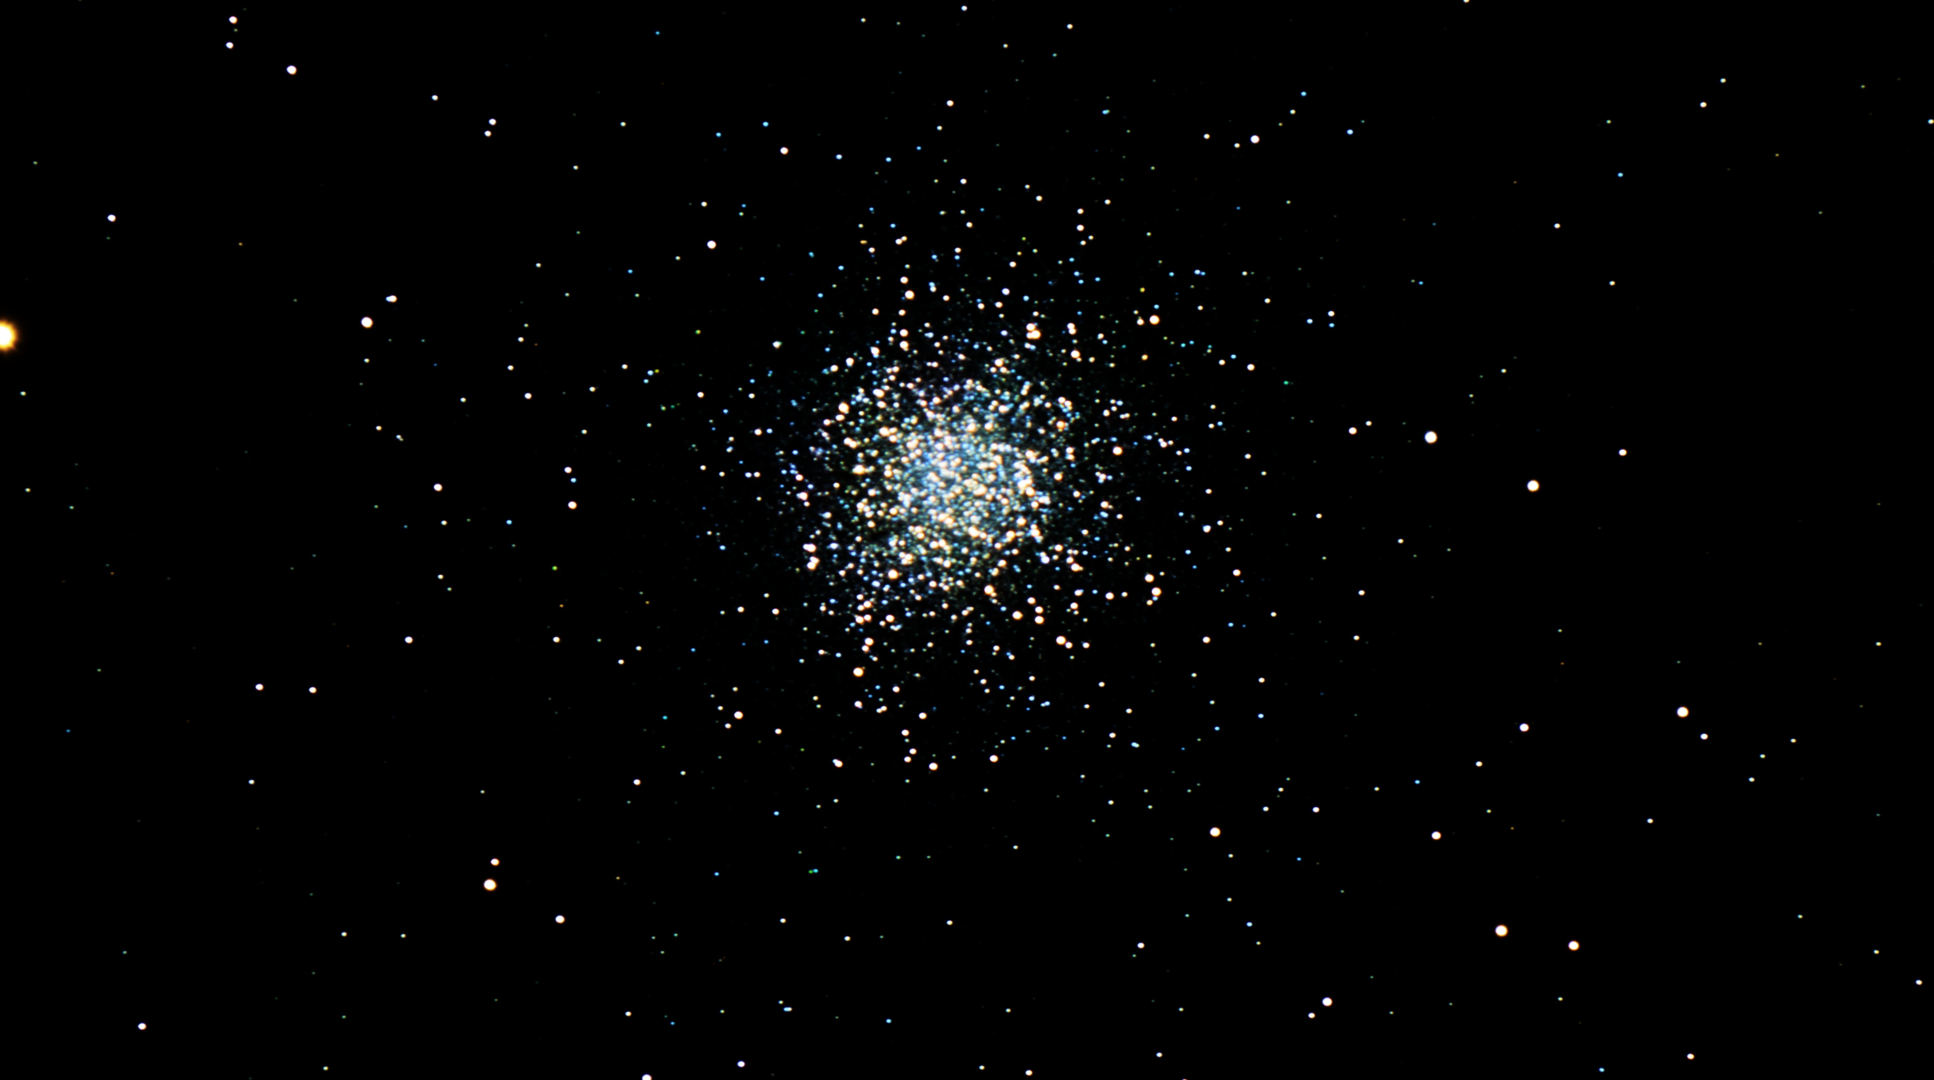
Notes:
Here’s a newer image of M-13.
Notice the colors?
That’s the advantage of taking only 30 sec images instead of 300 seconds as in the previous image.
I also stretched this using a special tool called GAME.
That tool allows me to stretch the cluster in stages. At each stage the tool protects what I have already stretched. The net effect is to avoid blowing out the core of the cluster. You can see stars at multiple stages of evolution.
Look at the next frame and the H-R diagram .Then come back and identify the RGB, HB, Subgiant, and even MS stars. (The latter can be hard to see in this jpg image but many are easily visible in the original Tiff image.

Slide 40
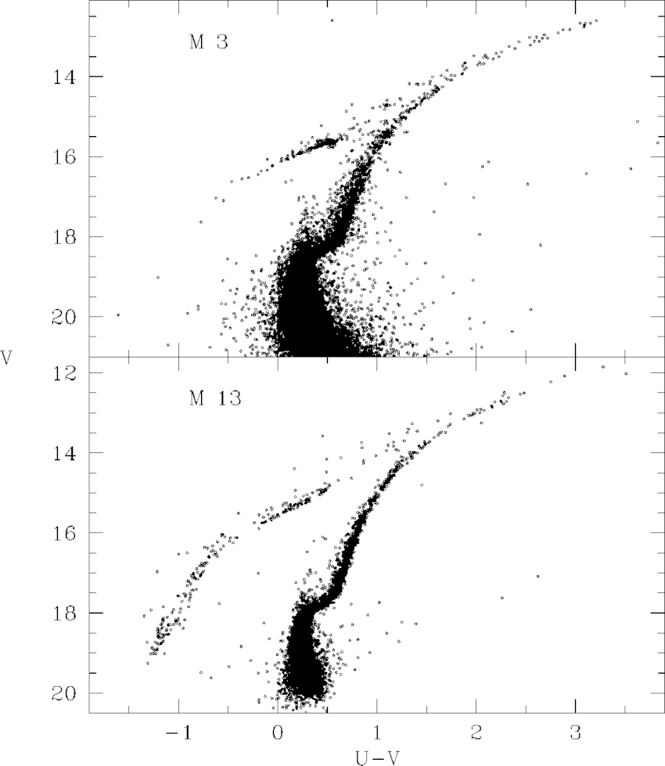
Notes:
Here is the H-R diagram of M-3 and M-13.
Technically this is a CMD diagram as the color index U-V is used rather than Spectral Class.
For M-13 look at the various branches and go back to the previous image and see if you can identify them.
If you look a the horizontal branch in the M-13 diagram you see a gap where there are few stars. This isn’t really a gap as there are a lot of stars here. But since they are variable you can’t really plot them as points. These are the RR Lyr type stars -sometimes called cluster variables but more often referred to by the AAVSO as SPP’s (Short Period Pulsators). The pulsation mechanism appears to be the same as in the Cepheids mechanism although these stars are of smaller mass than the classical Cepheids.

Slide 41
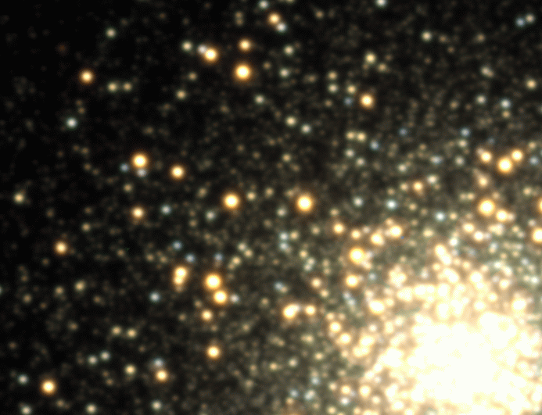
Notes:
This is not my image. I wish it was. This is a series of images taken over the space of a single night and combined to form a mini-movie.
This twinkling stars are the RR Lyr or SPP stars. Their periods are generally shorter than a day and the amplitude is small relative to the classical Cepheids

Slide 42
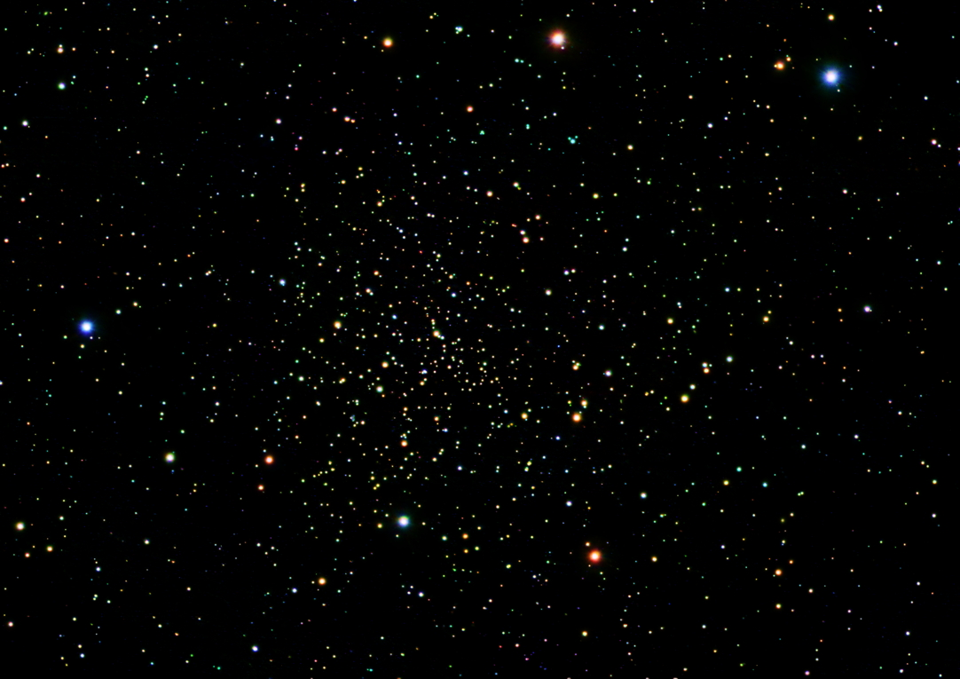
Notes:
Here is an older Open Cluster NGC 188.
Located only a few degrees from the NCP this is a older cluster- several billion years. It’s H-R diagram has taken on some the features of globular cluster but still retains typical Open Cluster features as well

Slide 43
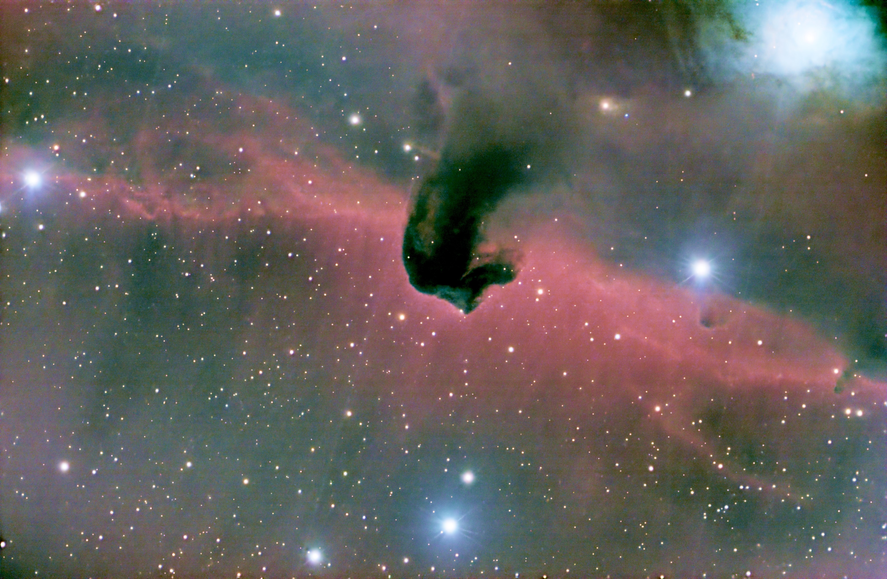
Notes:
The Horsehead nebula.
Notice how the star count decreases toward the top as the dust cloud density increases?
In processing this you really need dark and dry nights. When nebulosity covers the entire image it is very hard to get rid of the garbage in the image without losing data in the object itself.

Slide 44
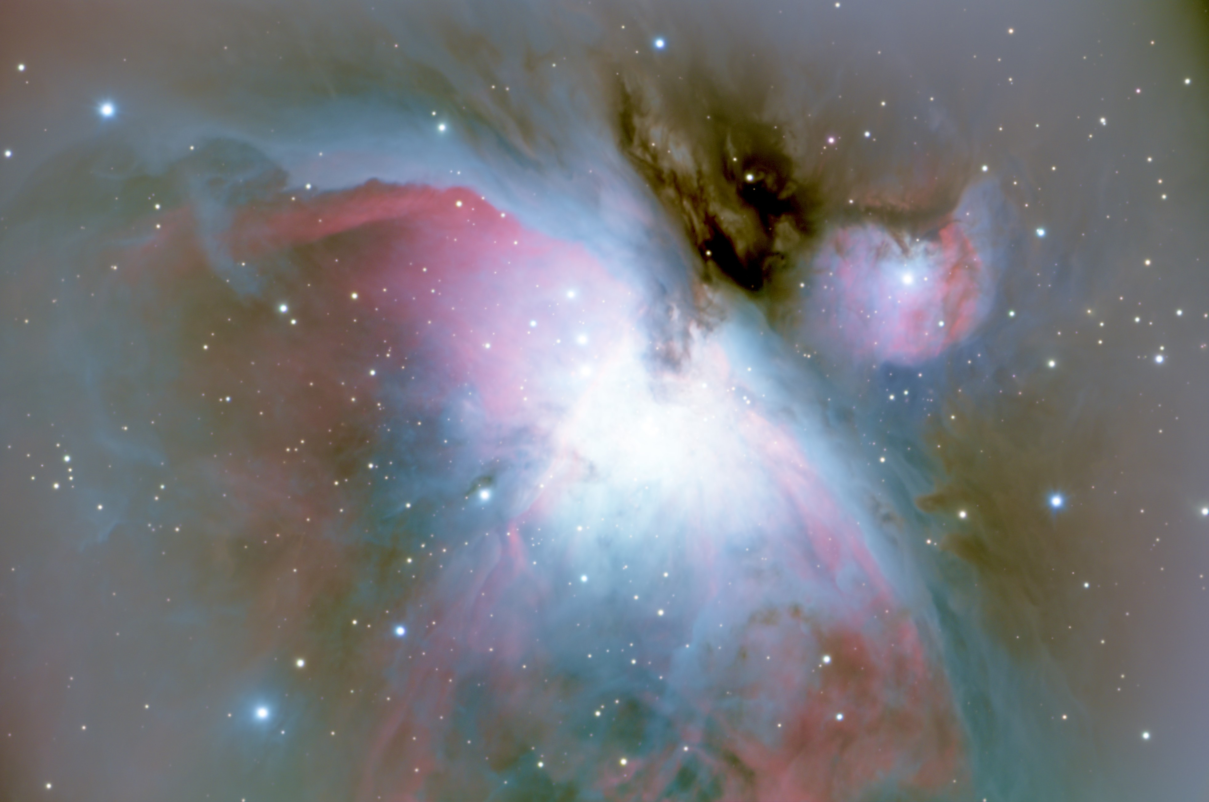
Notes:
Everyone’s favorite.
There is a real 3D Effect here. M-43 looks like it it clearly part of the underlying nebula but with obscuring dust cloud getting in the way.
To me the expanding bubble nature of the nebula is obvious.
I am trying to figure out a way to process this nebula without blowing out the Trapezium - so far without much success.

Slide 45
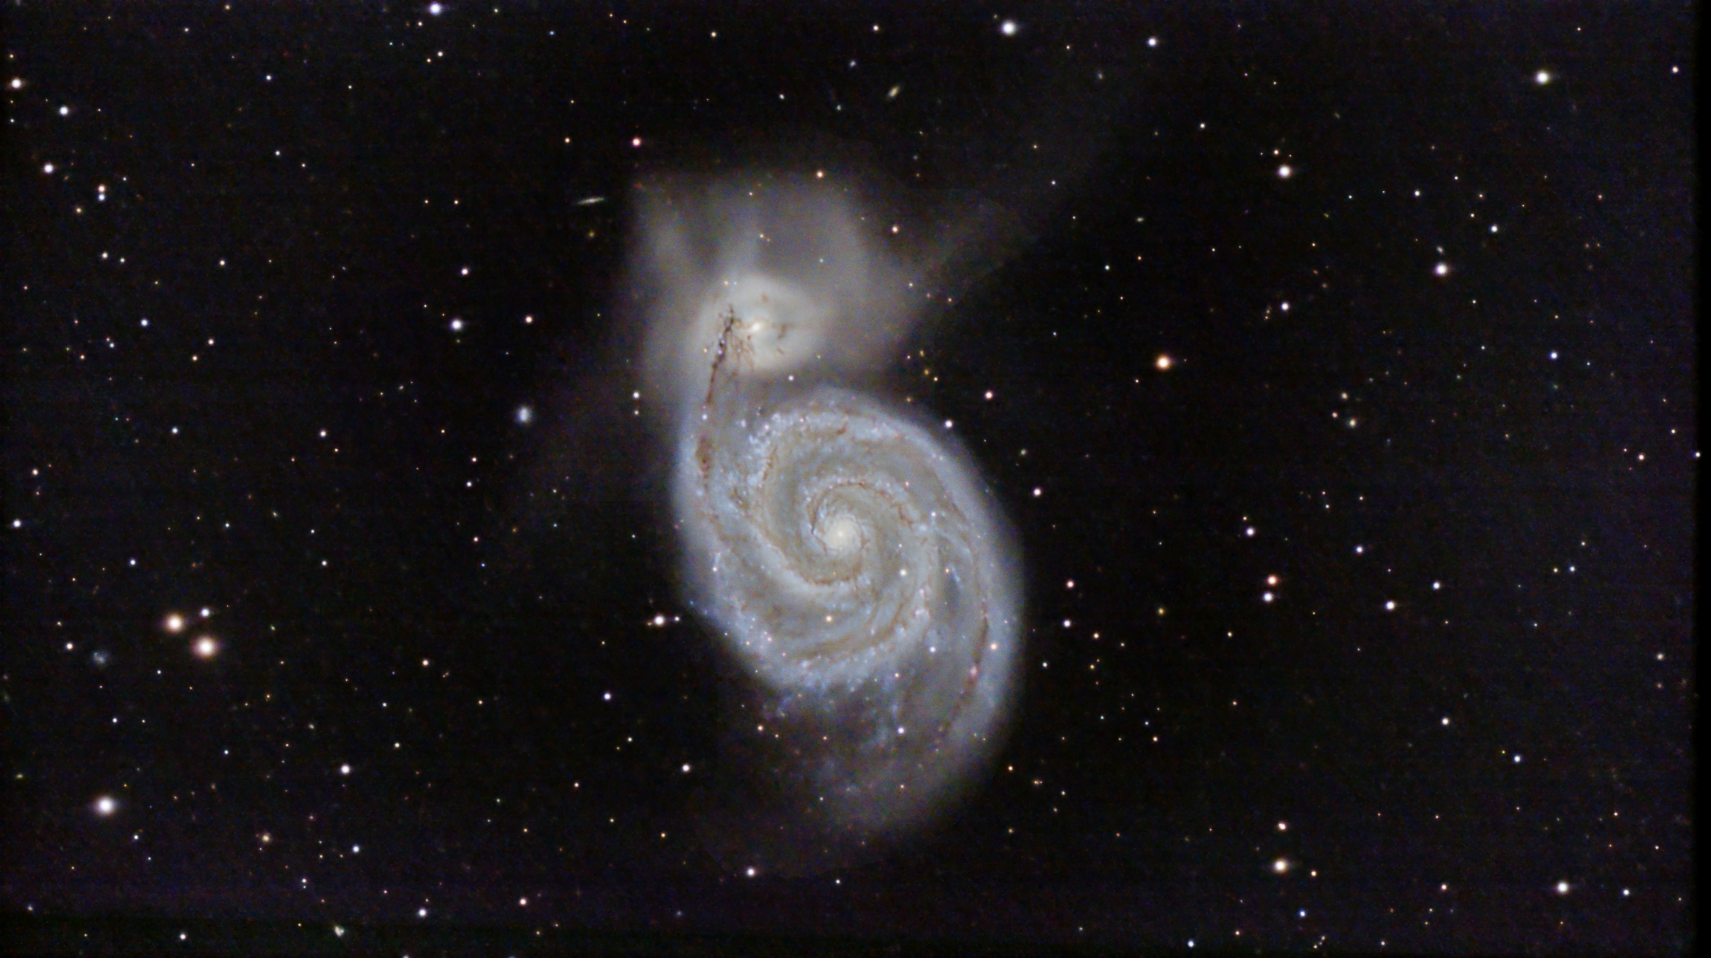
Notes:
M-51.
Back in my own college days in the late 1970’s this is what we figured the Milky way was- a Grand Design Spiral. We didn’t yet know the Milky Way had a central bar instead.

Slide 46
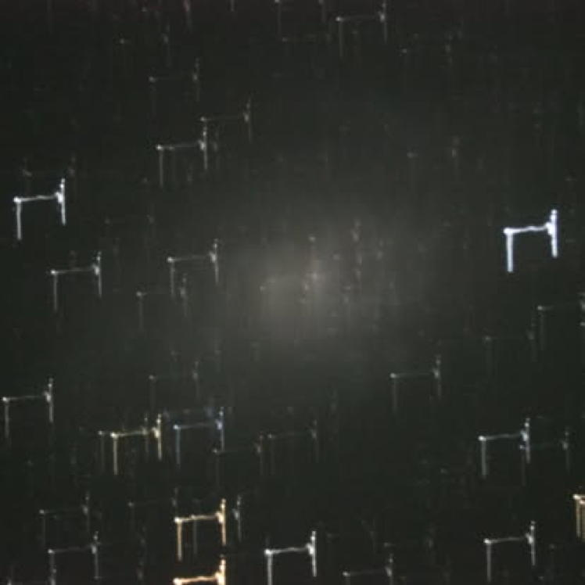
Notes:
These last three image are from my “Astrophotography by Dummies” collection.
I have no idea what the heck happened here.
The target was ostensibly M-33.

Slide 47
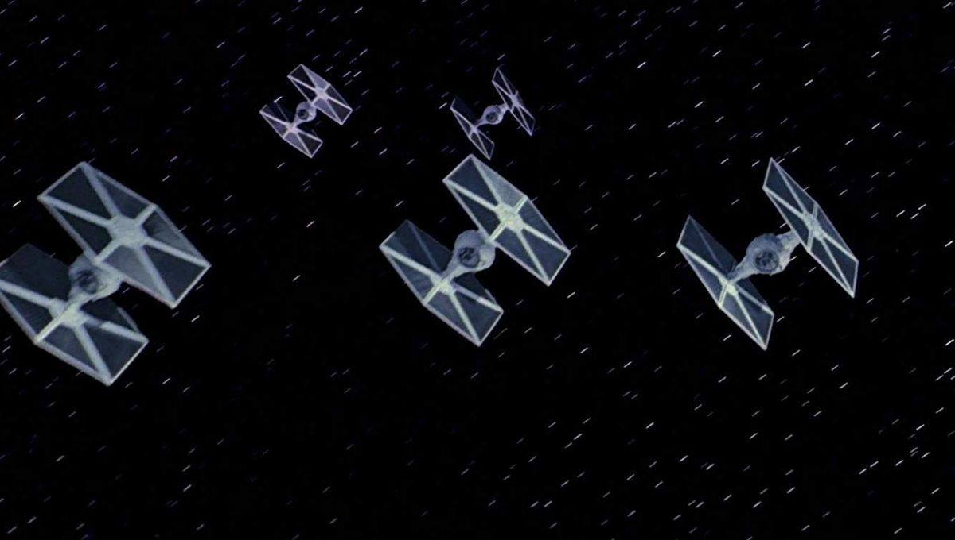
Notes:
A friend did some additional processing of the previous image. Here is what he found.

Slide 48
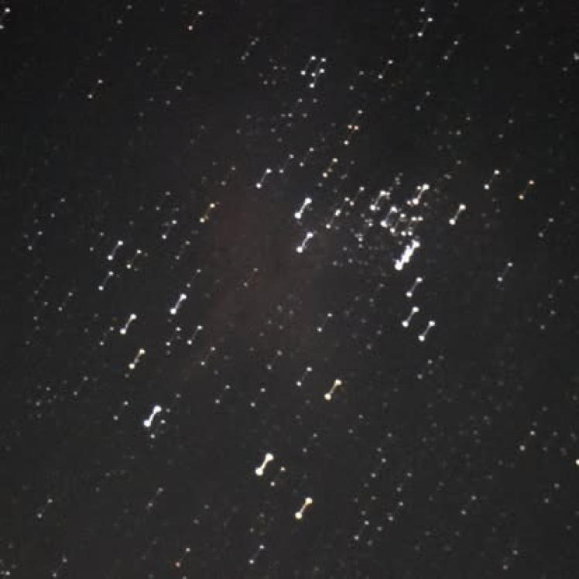
Notes:
The Barbell Cluster screwup.
This was an early attempt to image M 16.

Slide 49
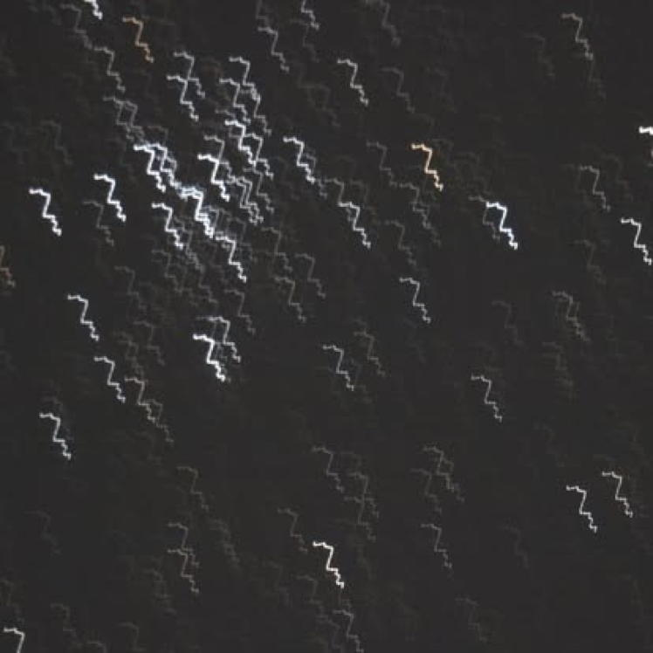
Notes:
This was supposed to be the Open Cluster M-36 in Aurigae. Nothing worked right that night.

Slide 50
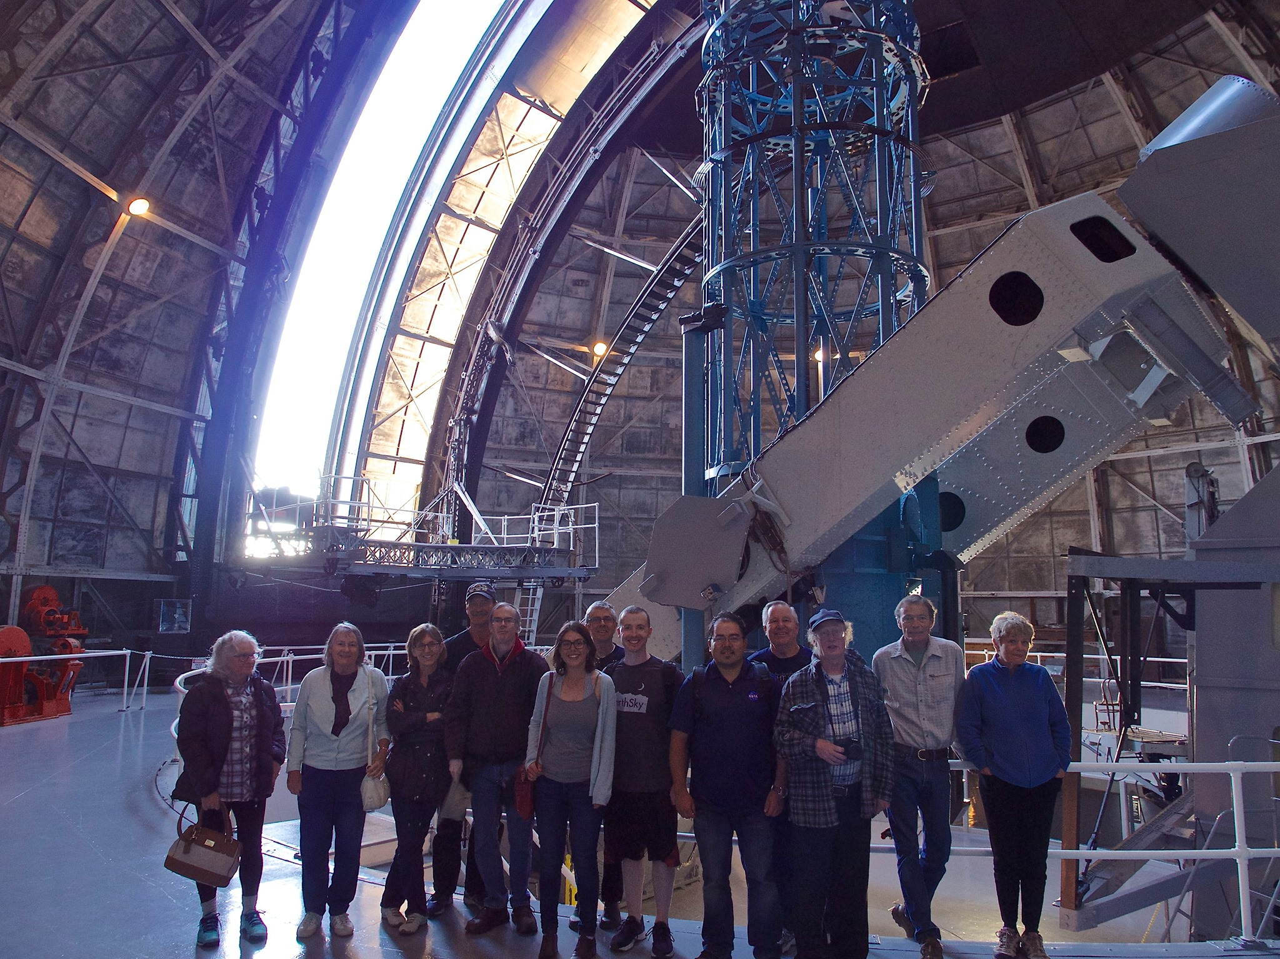
Notes:
Here is the 100 inch telescope at Mt.Wilson.
That glass plate of M-31 you saw earlier was taken here in 1923.

